Slide 1
Human Genetics
Module 9

Slide 2
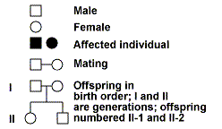
Studying Human Genetics
A PEDIGREE is used to study the inheritance of a single trait in a family
Symbols used in pedigrees:

Slide 3
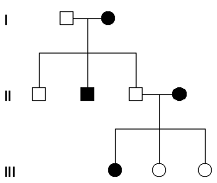
Pedigrees
Inheritance of an autosomal dominant trait
Individuals need ONE
dominant allele to express
the trait
Trait is present in every
generation
Trait is expressed in both
males AND females

Slide 4
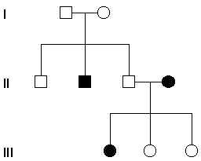
Pedigrees
Inheritance of an autosomal recessive trait
Individuals need TWO
recessive alleles to express
the trait
Trait skips a generation
Trait is expressed in both
males AND females

Slide 5
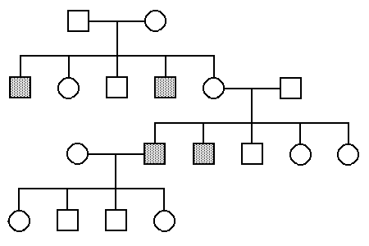
Pedigrees
Inheritance of an sex-linked recessive trait
Males need ONE recessive
allele to express the trait
Females need TWO recessive
alleles to express the trait
Females can “carry” the trait
Trait skips a generation
Trait is expressed more
often in males and is
inherited from mother to son

Slide 6
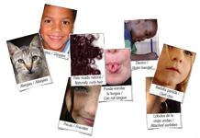
What is a trait?
TRAITS include “normal” characteristics
as well as genetic DISORDERS

Slide 7
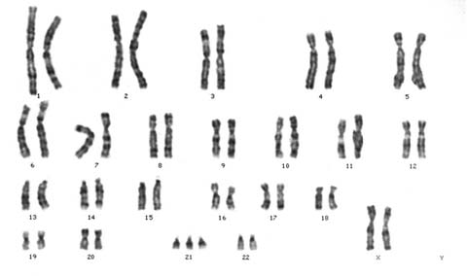
Karyotypes
A karyotype is a picture of chromosomes
A karyotype may show chromosomal disorders / aneuploidy (an abnormal #)
Autosomes:
the first 22 pairs
Sex chromosomes:
the 23rd pair

Slide 8
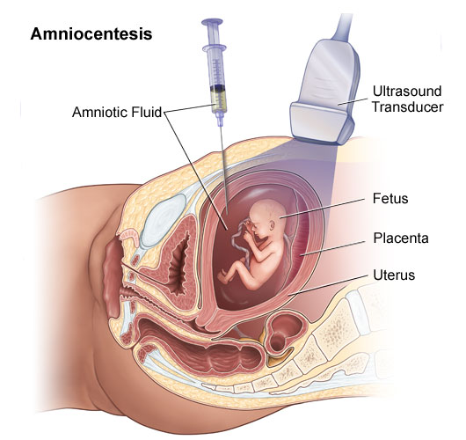
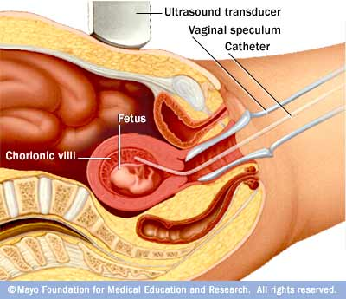
Karyotypes
How do we obtain chromosomes for a karyotype?
All cells contain a complete copy of the chromosomes
We can obtain cells from a fetus using 2 methods:
Amniocentesis
Chorionic Villi Sampling

Slide 9
Gene disorders
Can NOT be “seen” on a karyotype!
Involve the inheritance of a faulty GENE
GENE: a section of DNA that codes for a particular protein; PROTEINS DETERMINE TRAITS

Slide 10
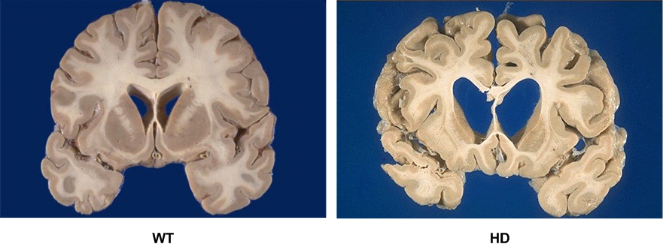
Gene Disorders
Huntington’s Disease
Inherited as: autosomal dominant
HH – has trait
Hh – has trait
hh – no trait
Appears after age 40; leads to gradual deterioration of the brain and eventual death

Slide 11
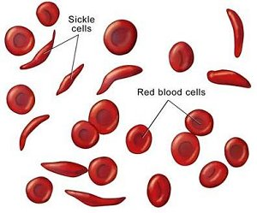
Gene Disorders
Sickle-Cell Anemia
Inherited as: autosomal co-dominant
SS – has disease
SN – has trait
NN – no trait (normal blood cells)
Sickle-shaped red blood cells lead to poor circulation and pain; predominant in African/ African-American populations
Tiki Barber

Slide 12
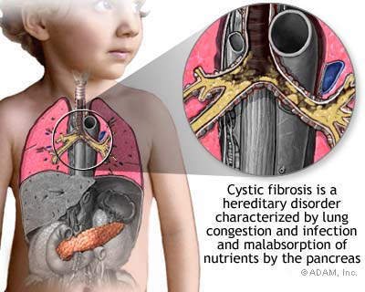
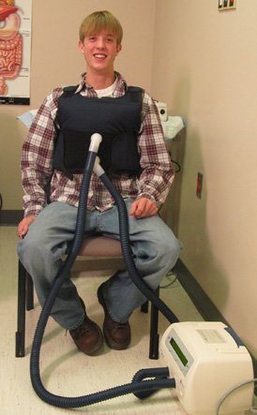
Gene Disorders
Cystic Fibrosis
Inherited as: autosomal recessive
CC – normal
Cc – normal, but “carries” the trait
cc – has disease
Leads to mucous build-up in lungs and digestive tract, usually fatal; predominant in Caucasian populations

Slide 13
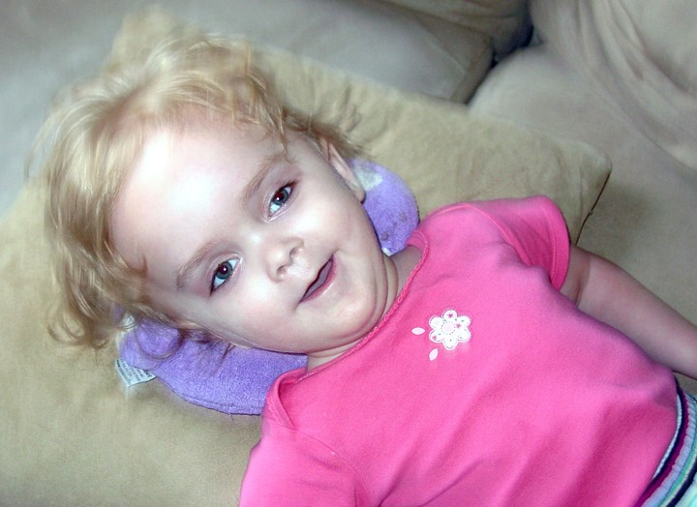
Gene Disorders
Tay-Sachs
Inherited as: autosomal recessive
TT – normal
Tt – normal, but “carries” the trait
tt– has disease
Breaks down the central nervous system leading to death by age 4; predominant in Jewish populations

Slide 14
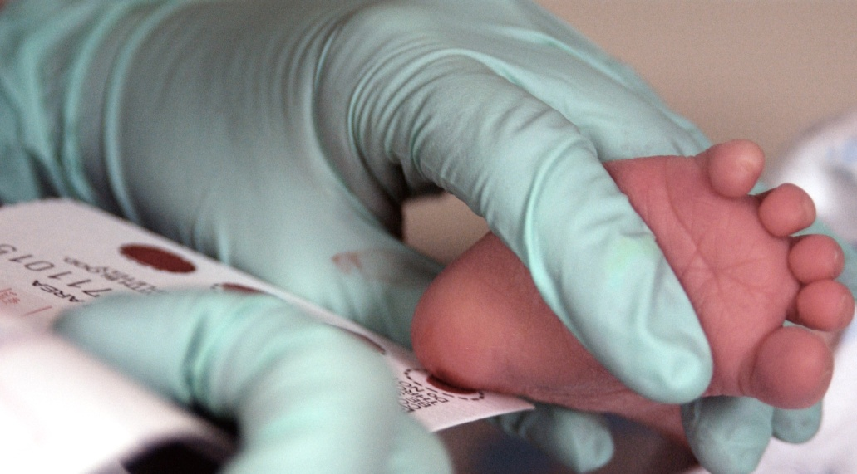
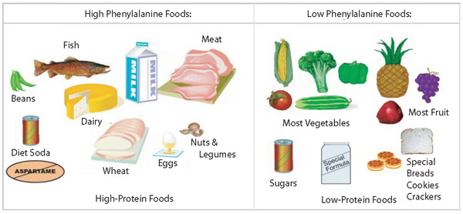
Gene Disorders
Phenylkentonuria (PKU)
Inherited as: autosomal recessive
PP – normal
Pp – normal, but “carries” the trait
pp– has disease
Inability to break down the amino acid phenylalanine, so it builds up in the brain; leads to decreased mental function, but can be controlled by diet

Slide 15
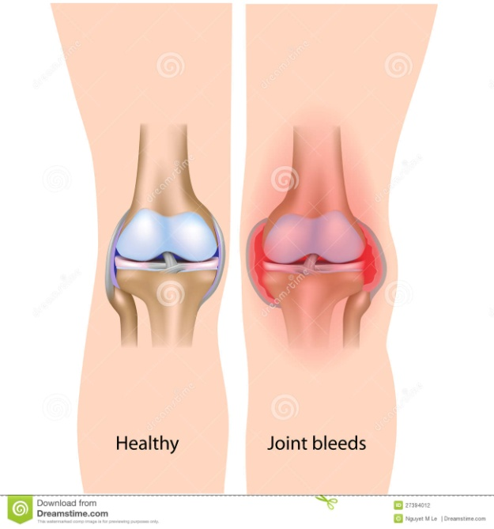
Gene Disorders
Hemophilia
Inherited as: sex-linked recessive
X^{H}X^{H} or X^{H}Y – normal
X^{H}X^{h} – normal, but “carries” the trait
X^{h}X^{h} or X^{h}Y – has disease
Low production of blood clotting factors leads to excessive bruising or bleeding

Slide 16
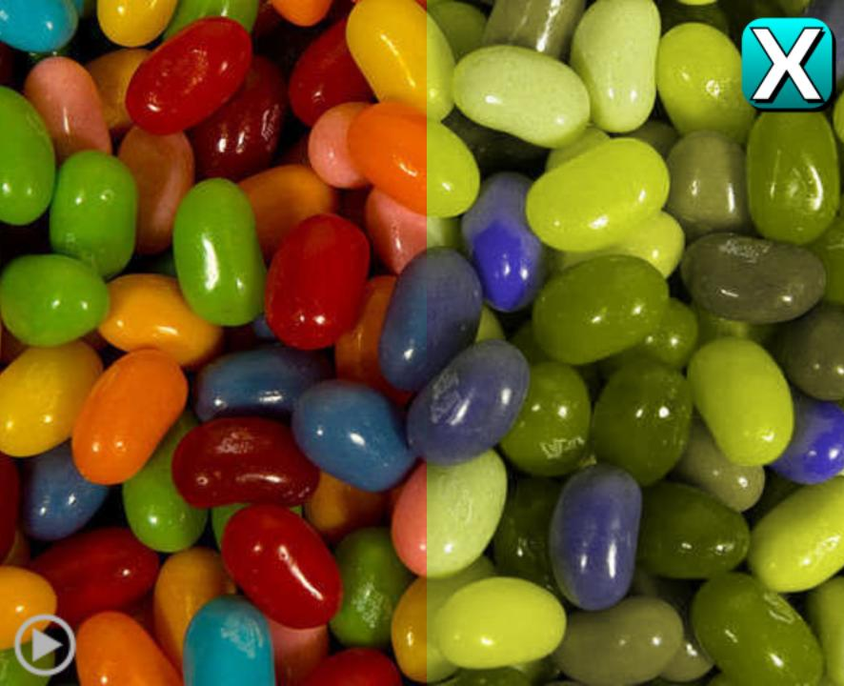
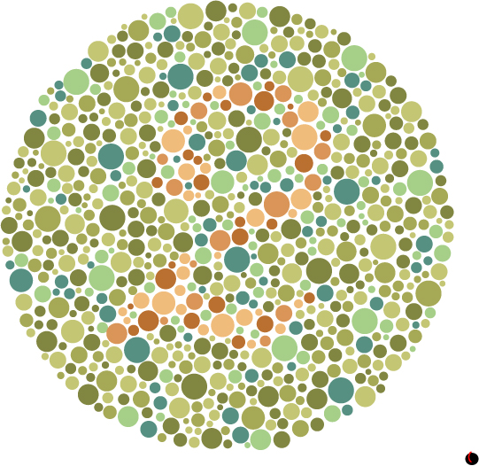
Gene Disorders
Red-Green Colorblindness
Inherited as: sex-linked recessive
X^{B}X^{B} or X^{B}Y – normal
X^{B}X^{b} – normal, but “carries” the trait
X^{b}X^{b} or X^{b}Y – has disease
Inability to distinguish between colors (especially reds and greens)

Slide 17
Chromosomal disorders
CAN be diagnosed using a karyotype!
Involve problems with an entire chromosome, which may contain 1000’s of genes!
ANEUPLOIDY: an abnormal number of chromosomes resulting from mistakes in meiois
23
24
23
23
VS.
46
47

Slide 18
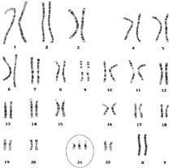
Chromosomal Disorders
Down’s Syndrome
Inherited as: autosomal aneuploidy;
Trisomy 21
Leads to mental impairment, heart defects, flat facial features, enlarged tongue

Slide 19
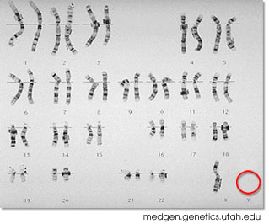
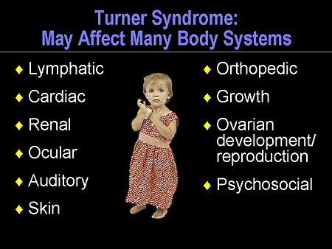
Chromosomal Disorders
Turner’s Syndrome
Inherited as: sex chromosome aneuploidy;
XO
Leads to mental impairment and infertility

Slide 20
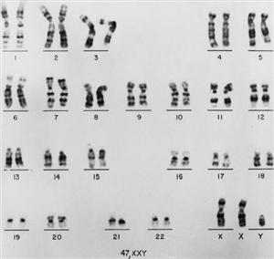
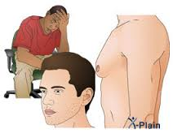
Chromosomal Disorders
Klinefelter’s Syndrome
Inherited as: sex chromosome aneuploidy;
XXY
Leads to mental impairment and infertility

Slide 21
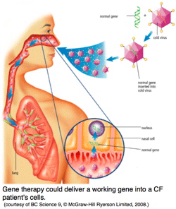
Gene Therapy
Genetic disorders can often be treated but can NOT be cured
The Human Genome Project has given us information that allows the development of gene therapies
GENE THERAPY:
Replacing a defective gene with a normal gene

