Slide 1
Cell REPRODUCTION
A STERNGRR process!!

Slide 2
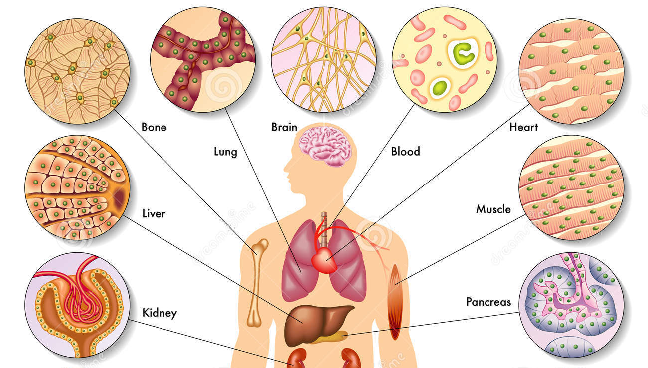
Why do cells divide
1. Surface area/volume ratio
Small cells more efficient at transfer of materials
2. Growth
Adding more cells to get bigger
3. Repair / Replace damaged cells
This occurs in somatic
(body) cells!

Slide 3
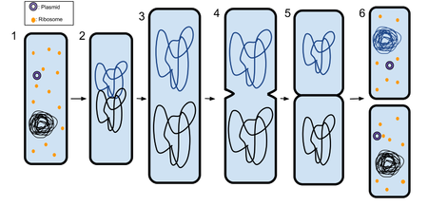
Cell division in different types of cells
Prokaryotic Cells:
NO NUCLEUS
Eukaryotic Cells:
Have a NUCLEUS
Nucleus contains chromosomes
Chromosomes must be duplicated before cell can divide (so new cell can receive a copy)
MITOSIS: the process of nuclear division

Slide 4
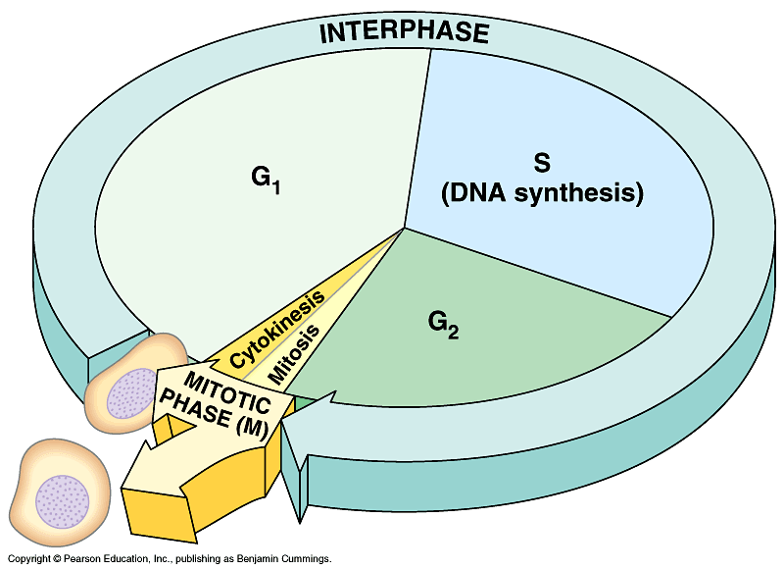
The Cell Cycle
Interphase:
The normal life of the cell
Cell is growing (G₁, G₂)
DNA (makes up chromosomes) is copied (S)
A doubled
chromosome

Slide 5
The Cell Cycle
Mitosis:
Eukaryotic cell division
Makes an identical copy (clone) of the parent cell
Number of chromosomes
46
Parent cell
46
46
Daughter cells

Slide 6
Process of Mitosis
Prophase
Pro –
Metaphase
Metaphase
Anaphase
Telophase
Starts with ONE cell
(parent)
Ends with TWO cells
(daughters) - clones of the parent
Cytokinesis is the
final division !

Slide 7
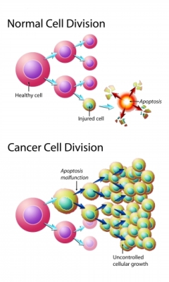
When mitosis goes wrong…
Uncontrolled cell division can lead to CANCER

Slide 8
Reproduction (of organisms) depends on CELL DIVISION
ASEXUAL:
Parents: 1
Offspring: identical (clones)
Cell division: Mitosis
12

Slide 9
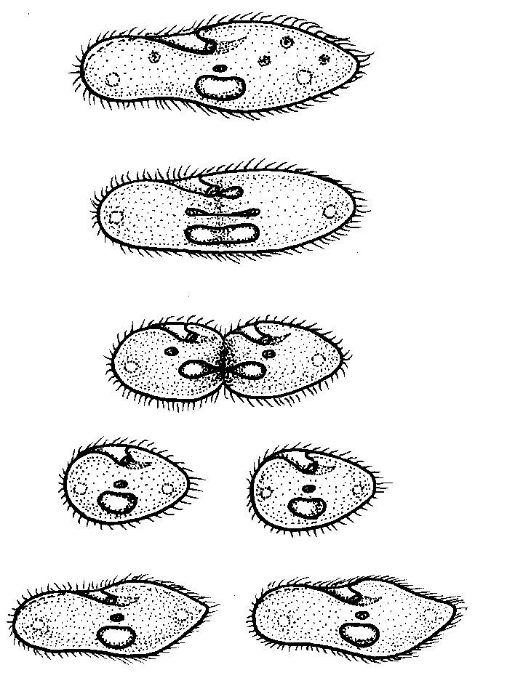
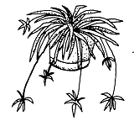
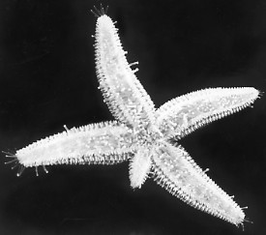
Types of Asexual Reproduction
Binary fission
Budding
Sporulation
Vegetative propagation
Regeneration

Slide 10
Sexual Reproduction
Parents: 2
Offspring: different
Cell division: MEIOSIS
46
23
23
MEIOSIS
Produces gametes:
SPERM and EGG
23
23
23
23

Slide 11
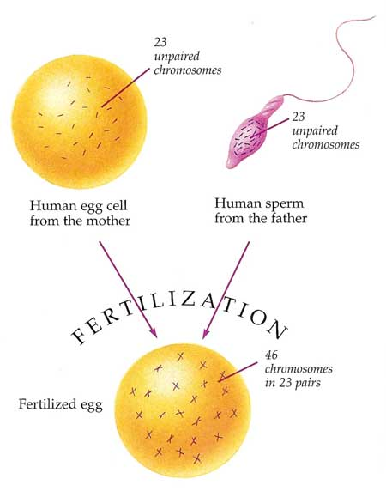
Why meiosis?
FERTILIZATION:
Meiosis - YouTube
23
+
23
=
46
EGG
(haploid)
HALF the normal # of chromosomes
SPERM
(haploid)
HALF the normal # of chromosomes
ZYGOTE
(diploid)
normal # of chromosomes
(2 of each)

Slide 12
Meiosis
CONS
Not as fast as asexual reproduction (can’t produce as many offspring)
Need to find a mate
PROS
Genetic variation
The MOST IMPORTANT
benefit!!!

Slide 13
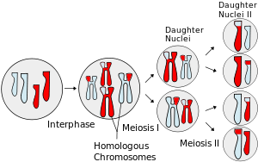
Genetic Variation in Meiosis
Genetic
Recombination
Crossing Over
Homologous chromosomes switch pieces

Slide 14
Genetic Variation in Meiosis
INDEPENDENT ASSORTMENT
Homologous pairs of chromosomes are “sorted” differently each time a gamete is formed
Sperm from the same man and eggs from the same woman can have different combinations of genes because of this independent assortment!
Example:
What are the possible gametes that will be produced from this diploid cell?
HINT:
Each gamete will get one “S” and one “T”

