Slide 1
Non-Mendelian Genetics
“Exceptions to the Principle of Dominance”

Slide 2
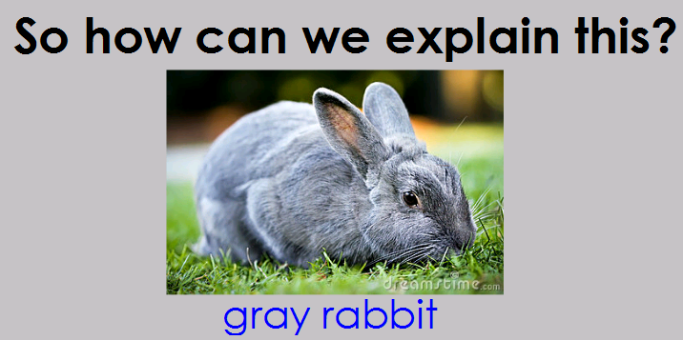

Slide 6
Incomplete Dominance = Blending of Traits
Primroses: Red x White = Pink
One parent has the homozygous genotype for red flowers and the other parent has the homozygous genotype for white flowers.
Neither phenotype is completely dominant over the other phenotype. This is why it is said to be incomplete dominance.
Therefore, in hybrids (heterozygotes) the phenotypes blend together to make a mixed new phenotype, pink!

Slide 7
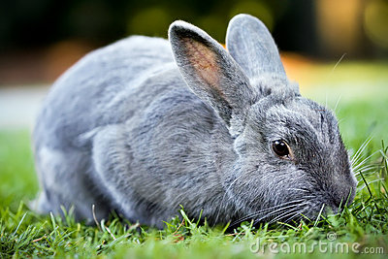
Incomplete Dominance = Blending of Traits
b. Gray Kittens and Rabbits: Black x White = Gray!
One parent has the homozygous genotype for black fur and the other parent has the homozygous genotype for white fur.
Neither phenotype is completely dominant over the other phenotype. This is why it is said to be incomplete dominance
Therefore, in hybrids (heterozygotes) the phenotypes blend together to make a mixed new phenotype, gray!

Slide 8
Challenge Question!
If DNA controls the production of proteins and proteins are expressed as traits, how do you think the proteins are acting to produce pink flowers?

Slide 9
Sample Genetics Problems involving Incomplete Dominance (Blending)

Slide 10
Sample Genetics Problems involving Incomplete Dominance (Blending)

Slide 13
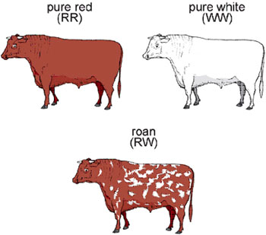
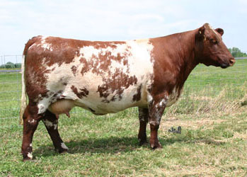
COdominance = BOTH Proteins / Traits Show
a. Roan Cows: Red x White = Roan (Roan = red cow with white splotches)
Both parents have homozygous dominant genotypes for different phenotypes of coat color
One parent has the phenotype for red coat color and the other parent has the phenotype for white color.
BOTH of the phenotypes are dominant so, consequently they are BOTH expressed as a third phenotype red + white. When this occurs in cows the red and white phenotype is called roan.

Slide 14
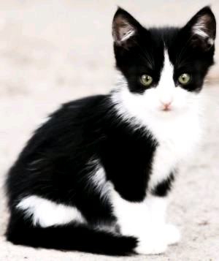
COdominance = BOTH Proteins / Traits Show
b. Black and White Cats: Black x White = black-and-white
One parent has the phenotype black and the other parent has the phenotype white.
BOTH of the phenotypes are dominant so, consequently they are BOTH expressed as a third phenotype black-and-white.
The offspring has a heterozygous genotype. In this case, the individual expressing this phenotype has black-and-white fur color.

Slide 15
Challenge Question!
If DNA controls the production of proteins and proteins are expressed as traits, how do you think the proteins are acting to produce roan cows?

Slide 16
Sample Genetics Problems involving Codominance (Both Show)

Slide 17
Sample Genetics Problems involving Codominance (Both Show)

Slide 18
Your Turn!
Problem Solving:
Intermediate Traits

