Slide 1
Human impact on the environment
An evidence-based journey

Slide 2
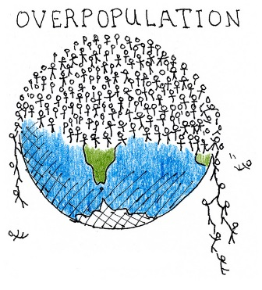
What is overpopulation?
World human population size has reached 7.4 billion and is still growing exponentially. Overpoplulation occurs when humans exceed the carrying capacity of Earth.
What CAUSES Overpopulation? | What are the EFFECTS of Overpopulation?
Claim: Human overpopulation is caused by reduced mortality (death) rates, better medical care, improved nutrition and food availability, and increased life expectancy. | Claim: Human overpopulation results in all other environmental concerns such as habitat destruction, biodiversity loss, global warming, and pollution.

Slide 3
Evidence for the causes and effects of human overpopulation
Read the article “Overpopulation”
Find specific quotes and examples to fill in for both “causes” and “effects.” We will do this first one together.

Slide 4
Human overpopulation
What CAUSES Overpopulation?
Evidence:
Decline in the Death Rate – “The discovery of agriculture by our ancestors was one factor that provided them with the ability to sustain their nutrition without hunting.”
Better Medical Facilities: (Industrial Revolution) “Technological advancement was perhaps the biggest reason why the balance has been permanently disturbed. “ → better means of producing food, discoveries to defeat diseases, vaccines
Fertility Treatments, Immigration, Lack of Family Planning

Slide 5
Human overpopulation
What are the EFFECTS of Overpopulation?
Evidence:
Depletion of Natural Resources: “Most of the environmental damage being seen in the last fifty odd years is because of the growing number of people on the planet. They are cutting down forests, hunting wildlife in a reckless manner, causing pollution and creating a host of problems.
Degradation of Environment: t the “the overuse of coal, oil and natural gas has” led to a “rise in amount of CO2 emissions leads to global warming.

Slide 6
Evidence for the causes and effects of human overpopulation
Use the internet to help you find NC examples
Use your HB notes, the “Overpopulation” article, and the internet to fill in possible solutions/corrections
20 minutes!

Slide 7
What is biodiversity loss?
Anything that contributes to having less species (and genetic) diversity.
What CAUSES Biodiversity Loss? | What are the EFFECTS of Biodiversity Loss?
Claim: Biodiversity loss is caused mainly by human overpopulation, which causes habitat destruction, global warming, acid rain, biological magnification, and invasive species. | Claim: Biodiversity loss results in less genetic diversity, altered ecosystems/food webs, and extinction.

Slide 8
What is biodiversity loss?
Let’s read the article “Biodiversity.
As we read look for “Evidence” examples (quotes) of Causes and Effects and write them down.

Slide 9
Evidence for the causes and effects of biodiversity loss
Read the article “NC’s Fading Forests” to find and record NC examples in your chart.
Use your HB notes, the articles, and the internet to fill in possible solutions/corrections

Slide 10
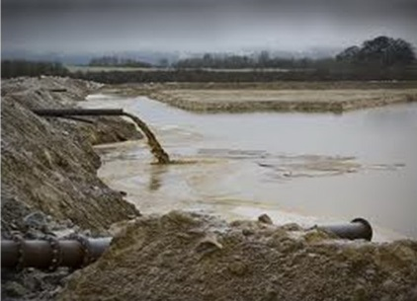
What is pollution?
Pollution is human introduced chemicals that can damage land, water, and air supplies.
What CAUSES Pollution? | What are the EFFECTS of Pollution?
Claim 1: Water pollution is caused by run-off from roads, farms, factories, acid rain, power plants, sewage plants, and hog farms. Claim 2: Air pollution is caused by burning fossil fuels in cars and factories, mining, and CFCs. | Claim 1: Effects of water pollution are a lack of clean drinking water, spread of infectious diseases, damage to ecosystems, and habitat destruction. Claim 2: Effects of air pollution are a lack of clean air and worsened allergies.

Slide 11
What is pollution?
Read/skim the following 3 articles:
“Factory Farmed Hogs” in North Carolina”
“More North Carolina Residents Warned of Contaminated Drinking Water”
“On a Clear Day You Can See Forever”
Find specific examples/quotes from the articles to record for each category:
Evidence for Causes
Evidence for Effects
NC examples
Possible Solutions

Slide 12
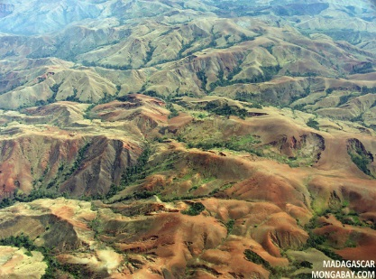
What is habitat destruction?
Habitat destruction is destroying habitats of plants and animals by human activities.
What CAUSES Habitat Destruction? | What are the EFFECTS of Habitat Destruction?
Claim: Habitat destruction is caused by: Fragmentation Deforestation Land development Over grazing and farming Global warming Acid precipitation | Claim: Habitat destruction causes a loss in biological diversity (biodiversity) which may lead to extinctions as well as a loss of resources.

Slide 13
What is habitat destruction?
Read/skim the following 3 articles:
“Habitat Loss”
“Saving Forests”
“Conserving North Carolina’s Wildlife Resources”
MYP: “The Deforestation of the Amazon”
Find specific examples/quotes from the articles to record for each category:
Evidence for Causes
Evidence for Effects
NC examples
Possible Solutions

Slide 14
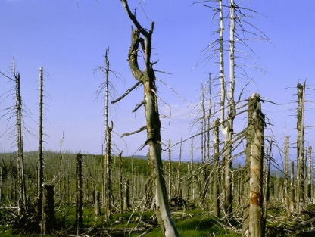
What is Acid precipitation?
It is precipitation that has a pH less than 5.6 (acidic).
What CAUSES Acid Precipitation? | What are the EFFECTS of Acid Precipitation?
Claim: Acid precipitation is caused by emissions of nitrous oxides and sulfur oxides from cars and factories (burning fossil fuels). | Claim: Acid precipitation kills plants and fish, releases toxic chemicals, causes erosion, and makes soil less fertile.

Slide 15
What is Acid precipitation?
Read/skim the following 2 articles:
“Acid Rain”
“Acid Rain and Air Quality in the Appalachians”
Find specific examples/quotes from the articles to record for each category:
Evidence for Causes
Evidence for Effects
NC examples
Possible Solutions

Slide 16
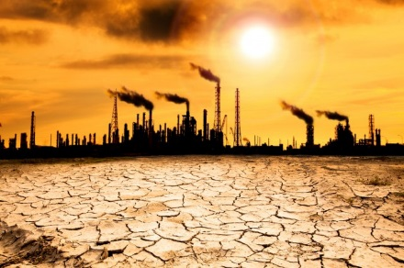
What is global warming?
Global warming is an increase in the global temperatures due to an enhanced greenhouse effect.
What CAUSES Global Warming? | What are the EFFECTS of Global Warming?
Claim: Global warming is caused by an increase in greenhouse gasses (CO₂, methane, water vapor) due to burning fossil fuels, which traps excess heat around the planet. | Claim: Global warming causes: Coastal flooding Changes in weather patterns melting polar ice caps increased storm frequency and intensity habitat destruction biodiversity loss

Slide 17
What is global warming?
Read/skim the following article:
“Global Warming 101”
Find specific examples/quotes from the article AND THE INTERNET to record for each category:
Evidence for Causes
Evidence for Effects
NC examples
Possible Solutions

Slide 18
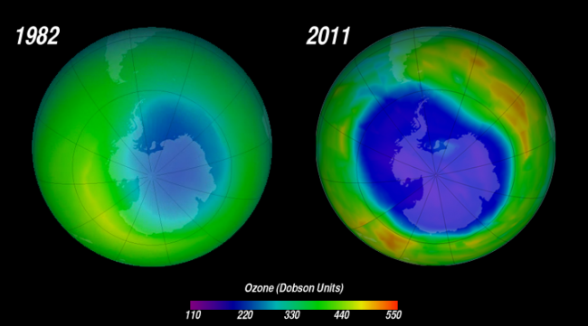
What is ozone depletion?
The ozone layer forms a protective barrier against harmful UV radiation from the sun. The ozone layer is deteriorating allowing more damaging UV light to reach Earth’s surface.
What CAUSES Ozone Depletion? | What are the EFFECTS of Ozone Depletion?
Claim: Ozone depletion is caused by harmful chemical pollutants such as CFCs (chlorofluorocarbons) in spray cans. | Claim: The effects of ozone depletion are damage to DNA, which causes skin cancer and cataracts, and harm to plants and animals.

Slide 19
What is ozone depletion?
Read/skim the following articles:
“The Ozone Depletion Phenomenon”
“Ozone Depletion: Losing Earth’s Protective Layer”
Find specific examples/quotes from the article AND THE INTERNET to record for each category:
Evidence for Causes
Evidence for Effects
NC examples
Possible Solutions

Slide 20
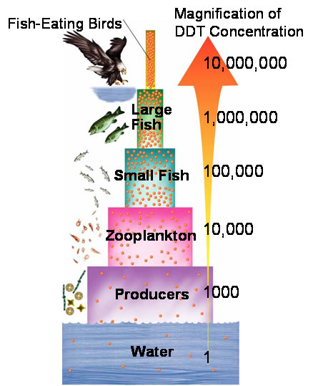
What is biomagnification?
First, let’s read the Student Fact Sheet “Biological Magnification” to get an understanding of what biomagnification is, the causes, the effects, and potential solutions.
Biological magnification (biomagnification) is the increasing concentration of a toxic chemicals (like pesticides) in the tissues of living things at successively higher trophic levels.

Slide 21
What is biomagnification?
Biological magnification (biomagnification) is the increasing concentration of a toxic chemicals (like pesticides) in the tissues of living things at successively higher trophic levels.
What CAUSES Biomagnification?
Claim: Biomagnification is cuased by environmental pollution of toxic chemicals (lead, mercury) and pesticides (DDT).

Slide 22
What is biomagnification?
Biological magnification (biomagnification) is the increasing concentration of a toxic chemicals (like pesticides) in the tissues of living things at successively higher trophic levels.
What are the EFFECTS of Biomagnification?
Claim: Biomagnification mostly harms higher trophic levels (top consumers) which can lead to a extinctions and a loss of biodiversity.

Slide 23
What is biomagnification?
Refer to the following articles AND THE INTERNET:
“Hazardous Links, Possible Solutions”
Student Fact Sheet “Biological Magnification”
MYP: “Tuna for Lunch: A Case Study for Examining Mercury Bioaccumulation and Biomagnification”
Find specific examples/quotes from the article AND THE INTERNET to record for each category:
Evidence for Causes
Evidence for Effects
NC examples
Possible Solutions

Slide 24
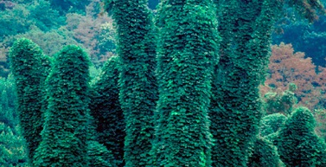
What are INVASIVE SPECIES?
Invasive species are organisms not originally from the area. When they are introduced to a new area they take over the ecosystem because they have no natural predators.
What CAUSES Invasive Species? | What are the EFFECTS of Invasive Species?
Claim: Invasive species are brought into areas both accidentally (on ships, planes, luggage) and intentionally (as pest control, pets, and exotic tokens). | Claim: Invasive species outcompete native species for resources. They have not predators and reproduce quickly leading to extinction of native species, loss of biodiversity, and spread of disease.

Slide 25
What are invasive species?
Refer to the following articles AND THE INTERNET:
“Invasive Species in North Carolina”
“Invasive Species”
“Kudzu”
Find specific examples/quotes from the article and the internet to record for each category:
Evidence for Causes
Evidence for Effects
NC examples
Possible Solutions

