Slide 1
Human Genetic Disorders
Chapter 11
CP Biology

Slide 2
Genetic Disorders
Major types of genetic disorders:
Autosomal
Single genes
Multiple genes
Sex-linked
Chromosome abnormalities

Slide 3
Autosomal Disorders
Autosomal genetic disorders are caused by alleles on autosomes (chromosomes other than the sex chromosomes)
Most are recessive (need 2 recessive alleles to have the disorder)
People with 1 recessive allele are carriers – they do NOT have the disorder but are able to pass the allele on to their children
Ex: Cystic fibrosis (CF), sickle cell anemia
Can also be dominant (need only 1 allele to have the disorder)
Ex: Huntington’s disease

Slide 4
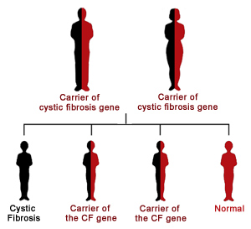
Cystic Fibrosis (CF)
Cystic fibrosis is the most common genetic disorder among white people
1 in 2500 white babies are born with CF (4-5 born every day)
It is estimated that 1 in 20 white people is a carrier for CF

Slide 5
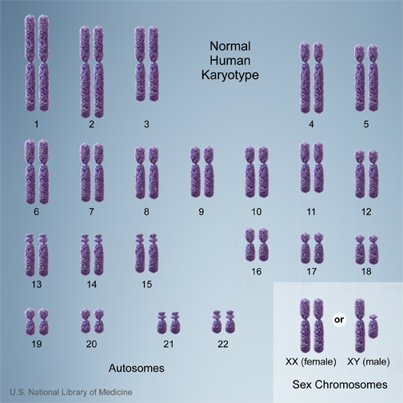
Cystic Fibrosis (CF)
Caused by an abnormal gene on chromosome 7
The gene is for a protein pump that uses active transport to regulate the movement of sodium (Na⁺) and chloride ions (Cl⁻) into and out of cells

Slide 6
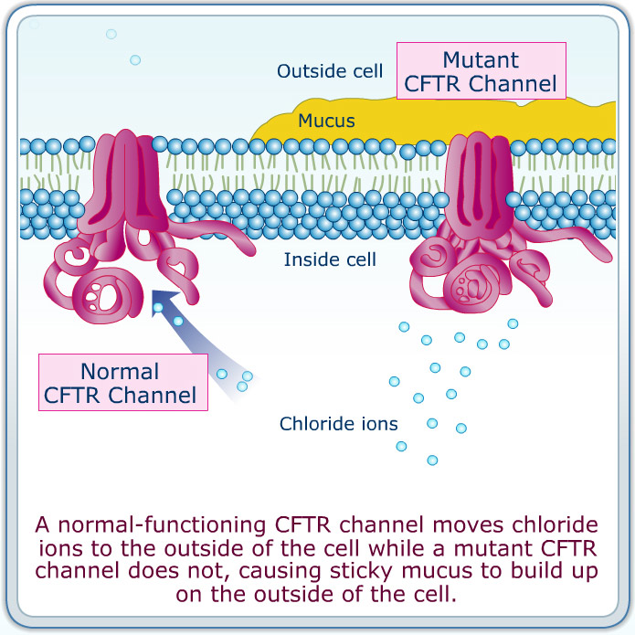
Cystic Fibrosis (CF)
In healthy individuals, the normal protein allows movement of Na⁺ and Cl⁻ ions
Keeps mucus thin and easily swept away
With CF, not enough Cl⁻ ions are pumped out
Thickening of mucus in airways and pancreatic ducts

Slide 7
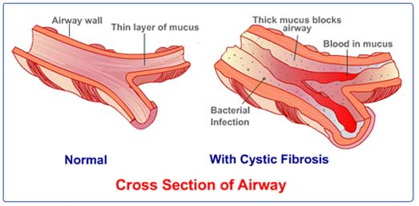
Symptoms of CF
Buildup of mucus in the lungs/ respiratory system
Difficulty breathing
Infections
Blocks digestive enzymes (produced by the pancreas) from entering the intestine
Malnutrition
Abnormal Na⁺ transport also results in salty sweat

Slide 8
Treatments for CF
For respiratory symptoms:
Physical therapy
Breathing exercises
Antibiotics
Lung transplants in severe cases
For digestive symptoms:
Capsules containing pancreatic digestive enzymes
Even with treatment, CF continues to be fatal, but patients live longer and have a higher quality of life

Slide 9
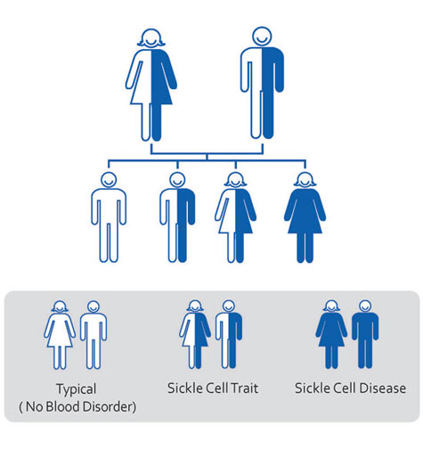
Sickle-Cell Anemia (Sickle-Cell Disease)
The most common genetic disorder among black people
About 1 in 500 African Americans has sickle-cell anemia.
Carriers are said to have sickle-cell trait

Slide 10
Sickle-Cell Anemia
Caused by an abnormal gene on chromosome 11
The gene is for one of the polypeptide chains in hemoglobin, a protein found in red blood cells that is responsible for transporting oxygen through the bloodstream

Slide 11
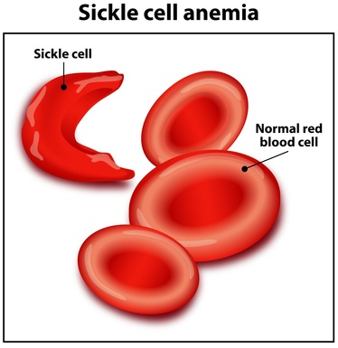
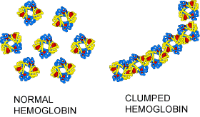
Sickle-Cell Anemia
Sickle-cell anemia causes hemoglobin to clump within red blood cells, which distorts their shape from the normal biconcave disc to a sickle shape.
People with sickle-cell trait have some abnormal hemoglobin but do not have the symptoms of sickle-cell disease.

Slide 12
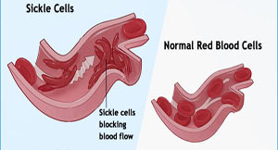
Symptoms of Sickle-Cell Anemia
Abnormal hemoglobin cannot deliver oxygen as efficiently to cells as in healthy individuals
Fatigue
Dizziness
Headaches
Sickled red blood cells cannot move as easily through capillaries as normal RBCs
Chronic pain, especially in bones
Reduced immune response to infections
Strokes

Slide 13
Treatments for Sickle-Cell Anemia
Treatments for sickle-cell anemia include:
Blood transfusions
Antibiotics
Drugs that increase oxygen-carrying capacity of RBCs
Drugs that “switch on” the gene for fetal hemoglobin, which is normally switched off after birth
Living with sickle-cell anemia

Slide 14
Heterozygote Superiority
Why are cystic fibrosis and sickle-cell anemia so common?
Sickle-cell anemia is most common in areas of the world where malaria is prevalent
Malaria is caused by a parasite that invades red blood cells
These parasites do not thrive in people with abnormal hemoglobin, so people with sickle-cell trait (who are heterozygous) are resistant to malaria.
People who are heterozygous for the cystic fibrosis allele may be more resistant to cholera
When carriers have an advantage over people who are homozygous dominant, it is called heterozygote superiority

Slide 15
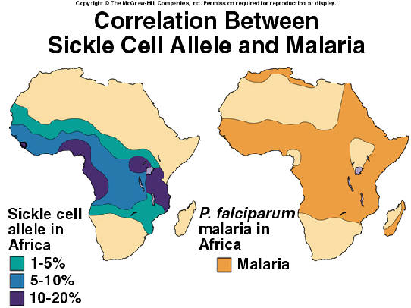

Slide 16
Huntington’s Disease
Caused by an abnormal dominant allele (unlike most human genetic disorders)
Both men and women need only one Huntington’s allele to get the disorder.

Slide 17
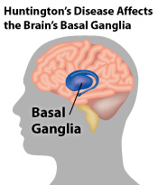
Symptoms of Huntington’s Disease
Huntington’s disease affects a person’s brain cells
Clumsiness
Irritability
Depression
Memory loss
Loss of muscle coordination & ability to speak
Symptoms normally appear by age 40
Huntington’s disease is always fatal
Death normally occurs within 20 years of the onset of symptoms
Living with Huntington’s

Slide 18
Multiple Genes
Cystic fibrosis, sickle-cell disease, and Huntington’s disease are all caused by mutant alleles for a single gene.
Many other genetic disorders are believed to be the result of multiple genes:
Diabetes mellitus
Heart disease
Some personality disorders
Bipolar disorder, schizophrenia
These are much more complicated to analyze than disorders caused by single genes

Slide 19
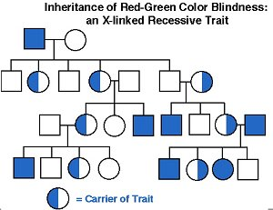
Sex-Linked Disorders
Sex-linked disorders are almost always caused by mutant alleles on the X chromosome
Hemophilia
Red-green colorblindness
Women can be carriers, but men cannot

Slide 20
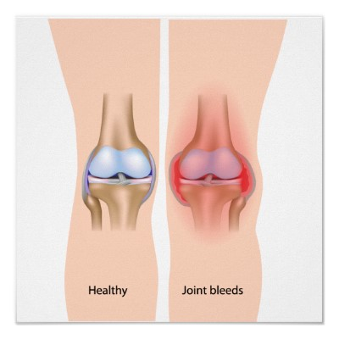
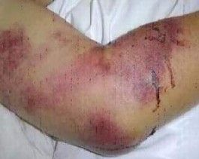
Hemophilia
Hemophilia is caused by an abnormal gene for a blood clotting factor (clotting factor VIII)
Blood does not clot normally, so even a tiny cut can result in excessive bleeding
Internal bleeding is a major concern
Most common around joints
Hemophiliacs bruise very easily

Slide 21
Red-Green Colorblindness
Red-green colorblindness is caused by an abnormal gene for photoreceptors in the retina
The genes for both red and green photoreceptors are located on the X chromosome – colorblindness can result from recessive alleles for either one or both of these genes

Slide 22
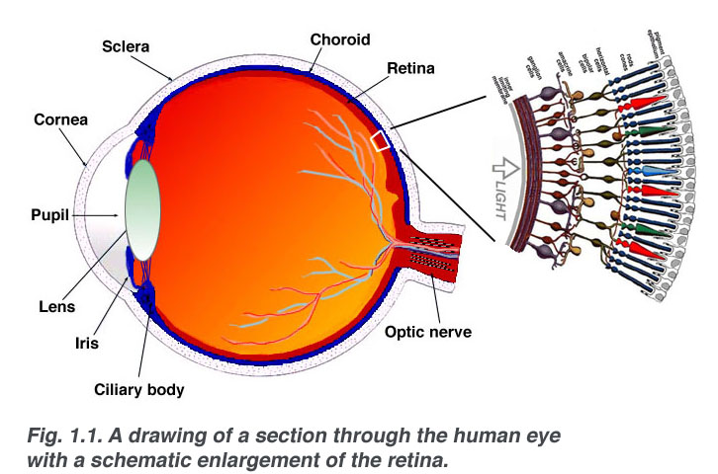
Photoreceptor Cells

Slide 23
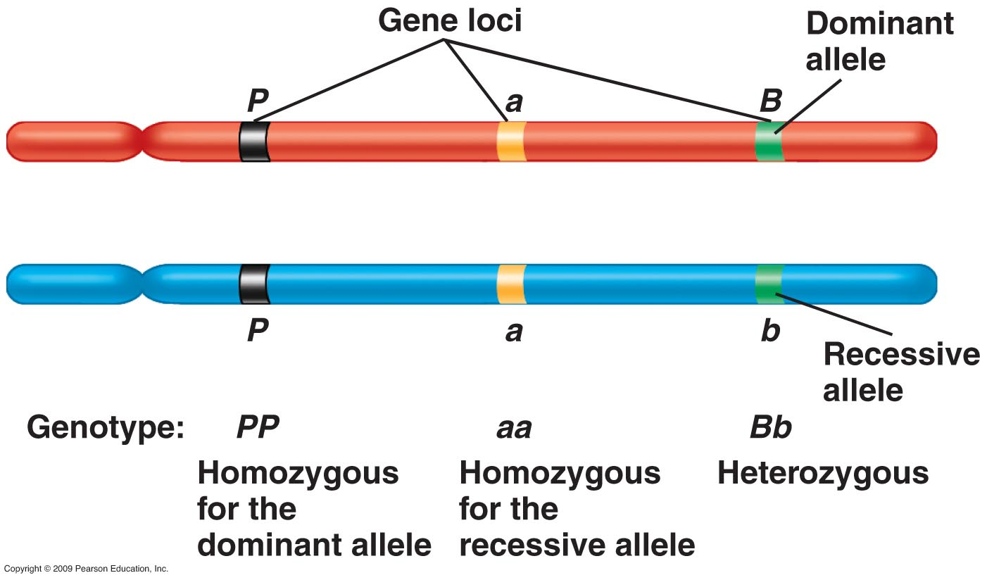
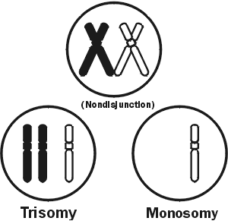
Chromosome Abnormalities
Autosomal and sex-linked genetic disorders are both caused by certain alleles – small segments of DNA that make up part of a chromosome
Other genetic disorders result from chromosome abnormalities caused by mistakes made during meiosis.
May change the number or structure of chromosomes within gametes

Slide 24
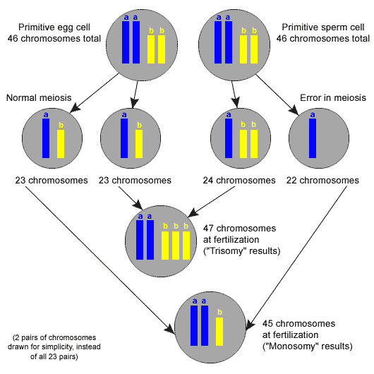
Nondisjunction
Nondisjunction is the failure of a pair of chromosomes to separate during meiosis
Results in one gamete having too many chromosomes and the other too few
Trisomy – a zygote gets 3 copies of a chromosome
Monosomy – a zygote gets only 1 copy of a chromosome

Slide 25
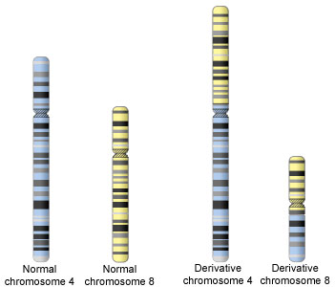
Translocation
Translocation is when a piece of one chromosome breaks off and attaches to a different chromosome
Often happens to 2 chromosomes at once

Slide 26
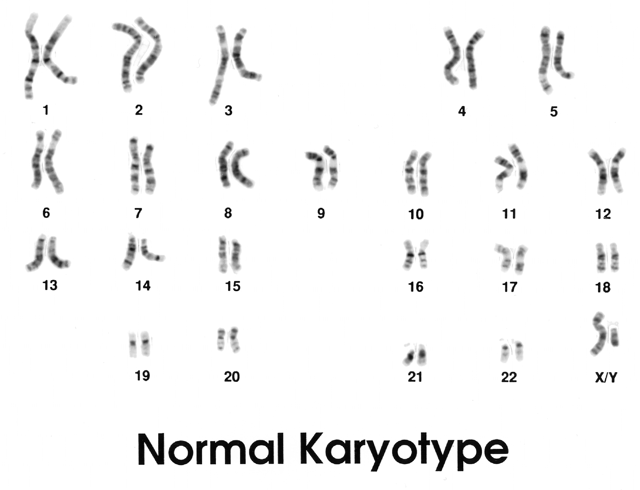
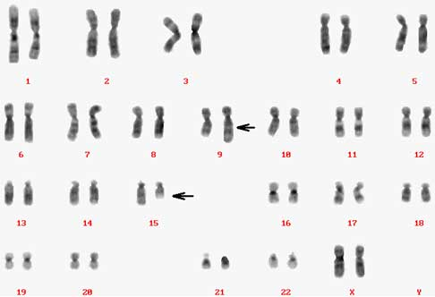
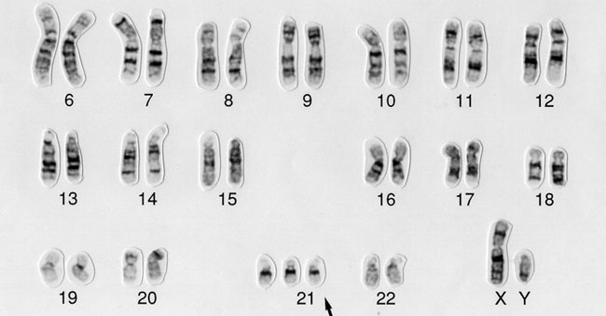
Karyotypes
Both nondisjunction and translocation can be detected in karyotypes
A karyotype is made from taking individual pictures of all of a human’s chromosomes and matching up homologous pairs

Slide 27
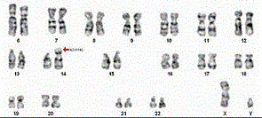
Down syndrome
Down syndrome - a genetic disorder caused by chromosome abnormality
Nondisjunction – the person has an extra copy of chromosome 21
Called trisomy 21
Translocation – most of chromosome 21 breaks off during meiosis and fuses with another chromosome, usually #14
This cause of Down syndrome is most likely to occur in children born to mothers over age 40

Slide 28
Down Syndrome
Symptoms of Down syndrome include:
Mild to severe mental retardation
Short stature
Heart, vision, and intestinal problems
Susceptibility to infections and leukemia

Slide 29
Congenital Disabilities
Congenital disabilities are different from genetic disorders
Not inherited
Occur during fetal development
Both genetic disorders and congenital disabilities can often (but not always) be detected before a baby is born

Slide 30
Genetic Counseling
Genetic counseling can help parents determine the likelihood of their child being born with a genetic disorder
Genetic counselors study the family histories of both parents
Create pedigree charts to trace the passage of traits
Medical geneticists analyze blood tests to determine if parents are carriers of certain genetic disorders
Genetic counseling usually can NOT determine whether or not a child will be born with a genetic disorder

Slide 31
Diagnosing Genetic Disorders
There are several ways to determine whether a child will have a genetic disorder
Two main ways to diagnose:
Analysis of fetal cells
Amniocentesis
Chorionic villus biopsy
Imaging techniques
Ultrasonography (computerized image)
Fetoscopy (direct observation)

Slide 32
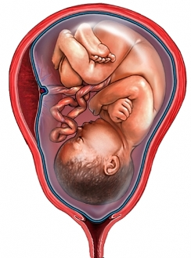
Amniocentesis
Amniocentesis
Amniotic fluid is the fluid that surrounds a fetus inside the uterus
Also contains fetal cells
A sample of amniotic fluid is taken and cells are grown in a lab
Can be used to make a karyotype – takes 10 days to grow enough cells
Detects chromosome abnormalities
Can be analyzed for defective alleles
Detects other genetic disorders
Cannot be conducted until the 14th week of pregnancy

Slide 33
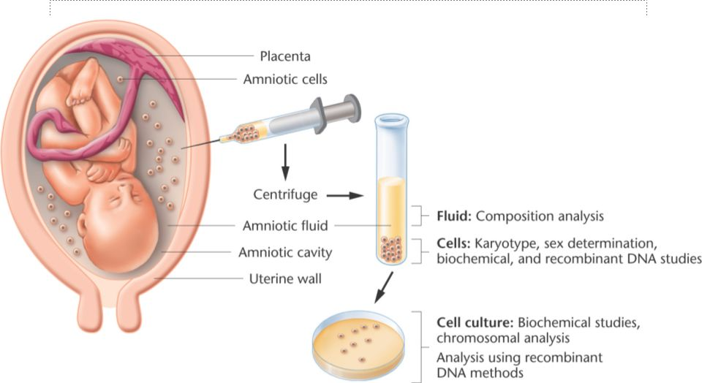
Amniocentesis

Slide 34
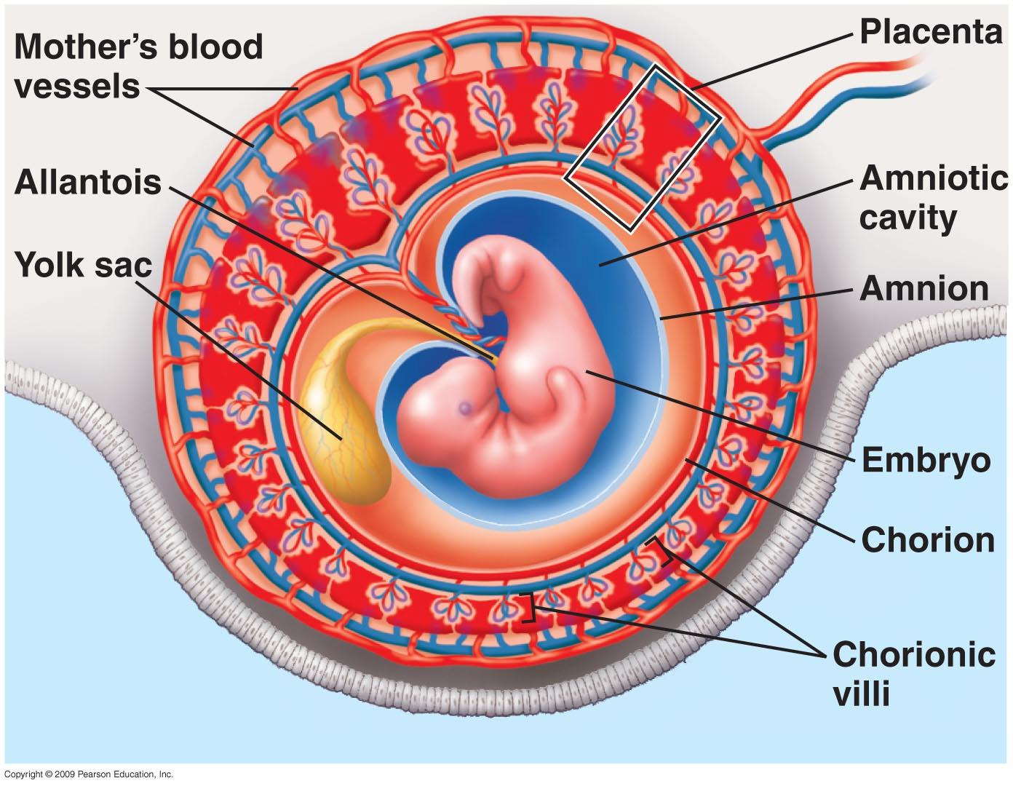
Chorionic Villus Biopsy
Chorionic villus biopsy
Chorionic villi are structures that help maximize the surface area for nutrient and gas exchange between a mother and developing fetus (they are part of the placenta)
The villi develop from fetal cells and therefore have the same chromosomes as the fetus & amniotic fluid
A sample of these cells can be taken and analyzed as in amniocentesis
Karyotyping
Tests for recessive alleles
Can be done as early as the 9th week of pregnancy

Slide 35
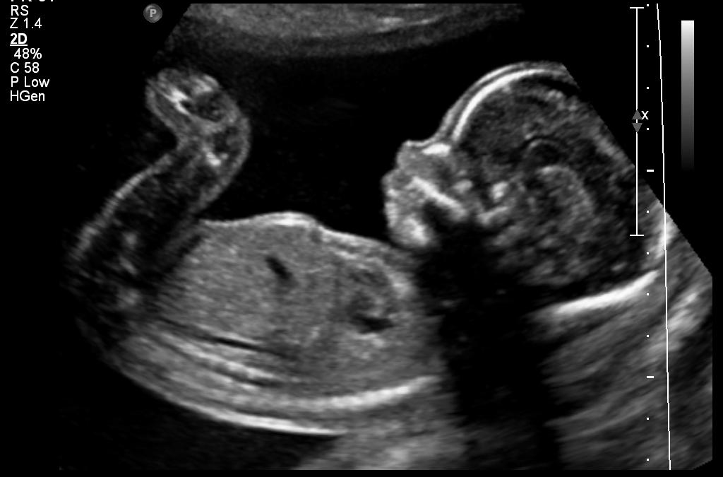
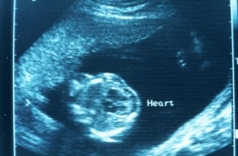
Ultrasonography
Uses high-frequency sound waves which bounce off of tissue
Depending on the density of tissue, waves “echo” back at different wavelengths and are used to produce a computerized image called an echogram
Used in most pregnancies to detect the position and anatomy of the fetus
Used with amniocentesis to reduce risk of injury
Can also help doctors detect abnormalities such as congenital heart defects

Slide 36
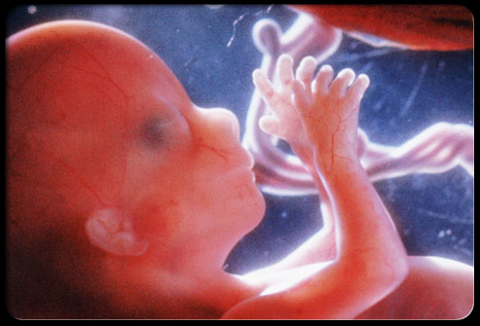
Fetoscopy
A small incision is made in a pregnant woman’s abdomen
An endoscope tube is inserted through the incision
Has a camera on the end that shows an image on a monitor
Instruments can be inserted through the endoscope to perform additional procedures

Slide 37
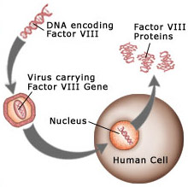
Developing Cures for Genetic Disorders
Gene therapy
Introducing normal genes into the cells of people with defective alleles
Using viruses to inject alleles into cells
Enclosing alleles in droplets of fat, which are taken into cells by endocytosis
Currently these are still experimental procedures and have had limited success

