Slide 1
GENETICS
Module 8

Slide 2
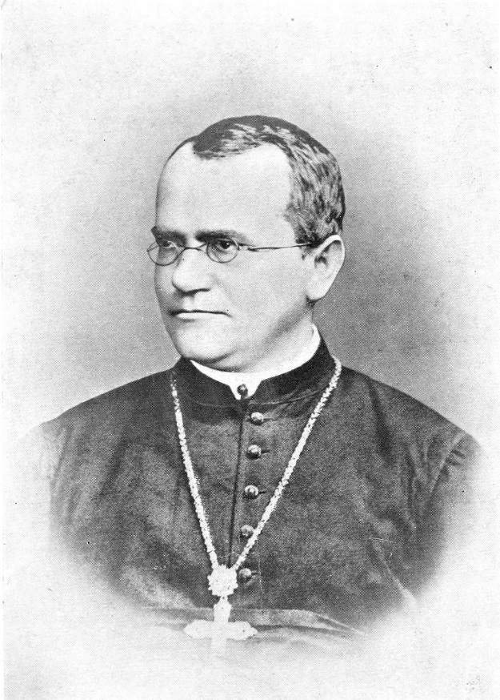
Genetics
Genetics is the study of HEREDITY or the INHERITANCE of traits
Gregor Mendel:
“Father of Genetics”
Worked with pea plants
to discover the principles
of heredity.

Slide 3
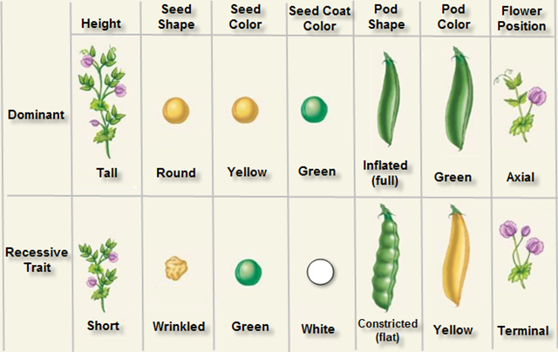
3 Principles of Heredity
Dominance: one form of a trait can hide or “mask” the other form

Slide 4
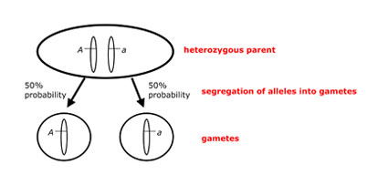
3 Principles of Heredity
Segregation: Each individual has 2 alleles for a trait, which are separated when the gametes are formed during MEIOSIS

Slide 5
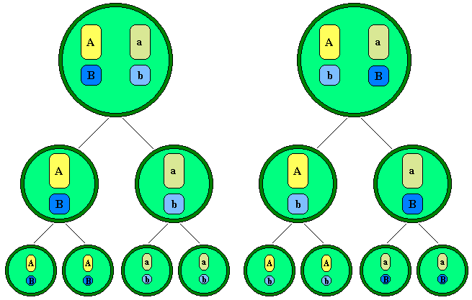
3 Principles of Heredity
Independent Assortment: Genes on chromosomes are separated independently of one another when the gametes are formed. This results in different combinations of genes in each gamete, allowing for genetic variation

Slide 6
Important terms to KNOW when studying genetics:
Term | Example | Definition
Dominant | T | A form of a trait that can hide/mask the other form
Recessive | t | A form of a trait that can be hidden / masked
Allele | T or t | A form, or version, of a trait
Genotype | Tt, TT, tt | The combination of alleles present in an organism for a particular trait
Phenotype | Tall | The physical expression of a trait
Homozygous | TT, tt | Having 2 of the SAME alleles for a trait; also called “purebreeding”
Heterozygous | Tt | Having 2 DIFFERENT alleles for a trait; also called “hybrid”

Slide 7
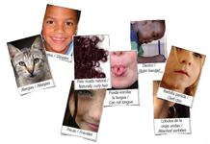
Remember….
A TRAIT is a physical or physiological characteristic of an organism.
Traits are determined
by your genes / DNA
which is a code for the
production of protein!

Slide 8
Nature vs. Nurture
“Nature” refers to your genes / DNA
“Nurture” refers to your environment
ex. food, education, medication, upbringing
Diseases often result from nature AND nurture:
Cancers
Diabetes
Heart disease
TWIN STUDIES give us information on nature vs. nurture
Twins: Is it All in the Genes? - Our America with Lisa Ling - Oprah Winfrey Network - YouTube

Slide 9
The SIX paths of inheritance
1. Mendelian (A, a)
2. Co-dominance (A, B)
3. Incomplete Dominance (A, A’)
4. Multiple Alleles (I^{A}, I^{B}, i)
5. Sex – Linked (X^{A}, Xª)
6. Polygenic (AaBbCc)

Slide 10
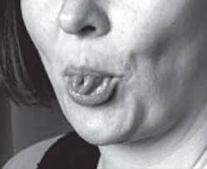
Mendelian (Dominant / Recessive)
Tongue-rolling is dominant to non- tongue rolling. Show a cross between a homozygous dominant tongue-roller and a non-tongue roller.
Heterozygote:

Slide 11
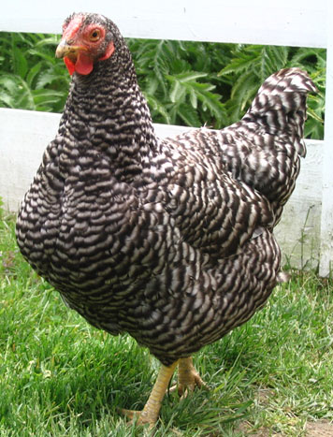
Co-dominance
Black feathers and white feathers in chickens are co-dominant. Show a cross between a black-feathered chicken and a white-feathered chicken.
Heterozygote:

Slide 12
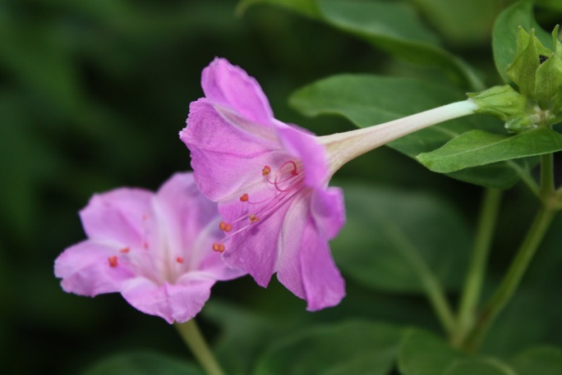
Incomplete Dominance
In four o’clock flowers, red petals and white petals are incompletely dominant. Show a cross between a red four o’clock and a white four o’clock
Heterozygote:

Slide 13
Multiple Alleles
Example: BLOOD TYPE
Show a cross between a man with type O blood and a woman with type AB blood. What are the phenotypes of their children?
Blood Type (Phenotype) | Possible Genotypes
Type A | I^{A}I^{A} or I^{A}i
Type B | I^{B}I^{B} or I^{B}i
Type AB | I^{A}I^{B}
Type O | ii

Slide 14
Sex Linkage
Example: Color-blindness
Sex-linked is X-linked!
Female heterozygote is a
“carrier” for the trait
Males show the trait
more often
Show a cross between a man who has normal vision and woman who is a carrier for color-blindness

Slide 15
Polygenic
Example: Skin color
NO PUNNETT SQUARE!
Graph shows a normal distribution where MOST individuals are average, but there are some at either extreme
Number of individuals
Skin color

