Slide 1
Unit 2: Ecology
MYP 2017

Slide 2
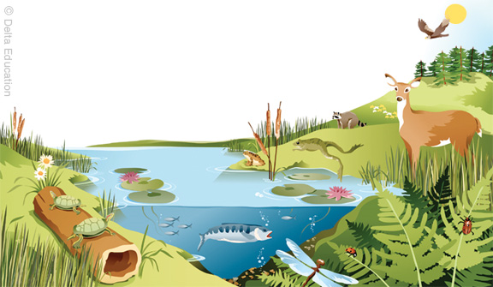
Biotic vs. Abiotic
living
BIOTIC =
ABIOTIC =
nonliving
Biotic | Abiotic

Slide 3
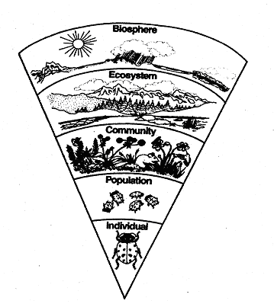
Biological Levels of Organization
We will start at the smallest level and work our way up!
ECOSYSTEM:
A group of different communities (organisms) living together in an area with their nonliving environment
Ex) a desert, a tropical rainforest, a tundra
POPULATION:
A group of individuals of the same kind (all one species)
Ex) a colony of ants, a grove of pine trees
COMMUNITY:
A group of different populations living in the same area
Ex) a forest, a meadow
BIOSPHERE:
The entire planet (land, water, atmosphere) where all the living things are
Ex) Earth
INDIVIDUAL/ ORGANISM:
a single living thing
Ex) a cat, a Paramecium, a bacterium, a tree

Slide 4
Amoeba Sisters!
Biological Levels – the World Tour (5:11)

Slide 5
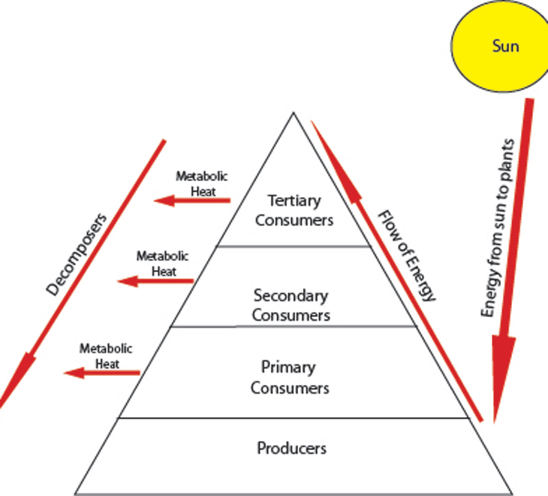
Trophic Levels
PRODUCERS = AUTOTROPHS:
Produce (synthesize) their own food (photosynthesis or chemosynthesis)
Ex: plants, aglae, some bacteria

Slide 6
Trophic Levels
CONSUMERS = HETEROTROPHS:
Eat/consume other living things
Ex: insects, bacteria, fungi, animals

Slide 7
Trophic Levels
Types of Consumers:
PRIMARY CONSUMERS = HERBIVORES
  first level consumers
  eat the producers
  Herbivores (plant eaters)

Slide 8
Trophic Levels
Types of Consumers:
SECONDARY CONSUMERS = eat primary consumers
  Carnivore = eats meat/animals
  Omnivore = eats both plants and animals
  Decomposer = eats dead/decaying material and recycles nutrients to the soil

Slide 9
Trophic Levels
Types of Consumers:
TERTIARY CONSUMERS =
  third level consumers
  eat secondary consumers
  Can be carnivores, omnivores, or decomposers
QUATERNARY CONSUMERS =
  fourth level consumers
  eat tertiary consumers
  Can be carnivores, omnivores, or decomposers

Slide 10
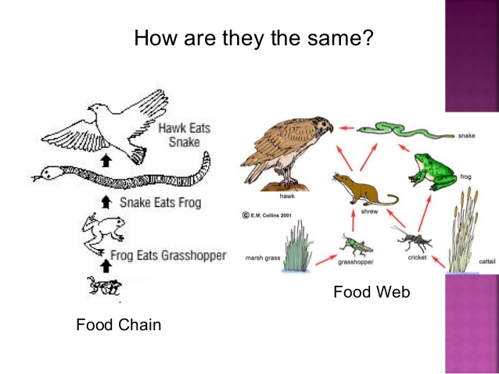
FOOD CHAIN
FOOD WEB
Single linear pathway showing the transfer of ENERGY from one TROPHIC level to the next
Complex, interconnected network of different food chains within an ecosystem
Shows many different pathways of energy

Slide 11
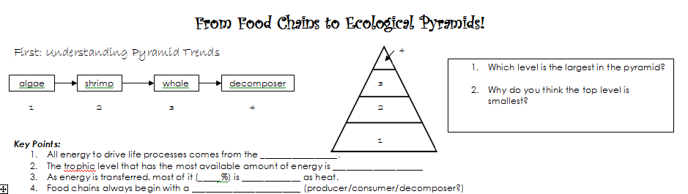
Level 1 (producer)
Because there are fewer numbers of organisms and there is less energy available
sun
Producer/Autotroph
90%
lost
producer

Slide 12
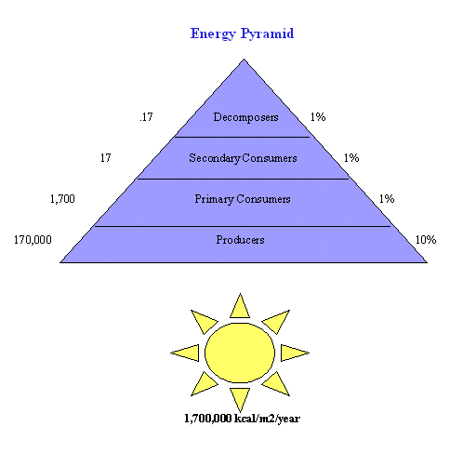
Pyramid of Energy
What it Shows…
the amount of energy passing through each trophic level over a period of time. It states that as you go up trophic levels, organisms lose energy. Thus, an ecosystem can support more producers than primary consumers, and more primary consumers than secondary consumers.

Slide 13
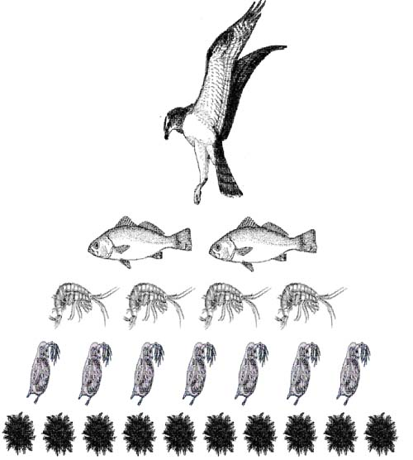
Pyramid of Numbers
What it Shows… the number of organisms at each trophic level. Greater numbers can be found at bottom trophic levels.

Slide 14
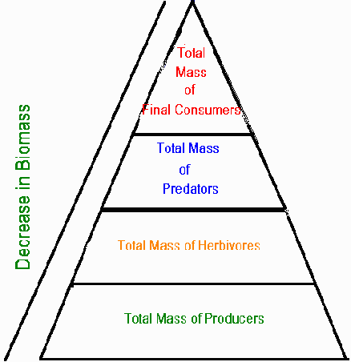
Pyramid of Biomass
What it Shows…
the mass (weight) of biological material at each trophic level. Bio = living mass = weight so biomass is another word for this living material.
Which trophic level has the greatest biomass?

Slide 18
Amoeba Sisters!
Food Webs and Energy Pyramids: Bedrocks of Biodiversity (5:49)

Slide 19

Max the Bear

