Slide 1
DNA and Heredity DNA Structure and Function - Amoeba Sisters
Module 6

Slide 2
DNA and Heredity
DNA stands for Deoxyribonucleic Acid
DNA is a NUCLEIC ACID
One of the “Core Four” organic compounds
DNA controls HEREDITY (the inheritance of traits)
DNA is passed from parent to offspring
DNA is a CODE for making PROTEINS and proteins determine TRAITS

Slide 3
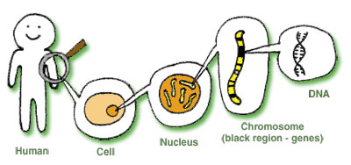
Where is your DNA?

Slide 4
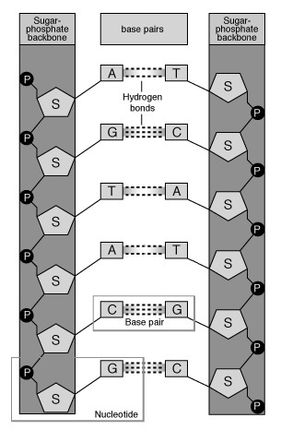
DNA Structure
The monomer (subunit) of DNA is a nucleotide
A nucleotide has 3 parts
Sugar (deoxyribose)
Phosphate group
Nitrogen base
There are 2 chains of nucleotides in a DNA molecule

Slide 5
DNA Structure
The shape of the DNA molecule is a double helix
The “backbone” of the double helix is alternating sugars and phosphates
The rungs of the DNA ladder are nitrogen base pairs
Nitrogen base pairs are connected by hydrogen bonds

Slide 6
DNA Structure
There are 4 nitrogen bases in DNA
Adenine
Thymine
Cytosine
Guanine
Base pairing is complementary
Adenine with Thymine
Cytosine with Guanine

Slide 7
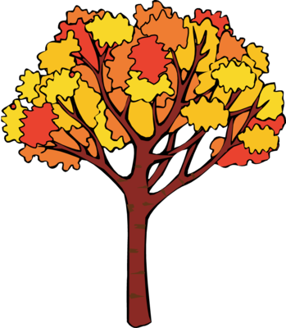
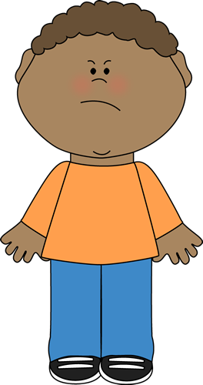
How is my DNA different from a tree or a frog?
Every living organism has DNA in its cells
All DNA has the same basic structure
The difference in human DNA, tree DNA, or frog DNA is the sequence of the nitrogen base pairs.

Slide 8
DNA Replication
DNA must make a copy of itself before a cell divides
This happens during INTERPHASE of the cell cycle!

Slide 9
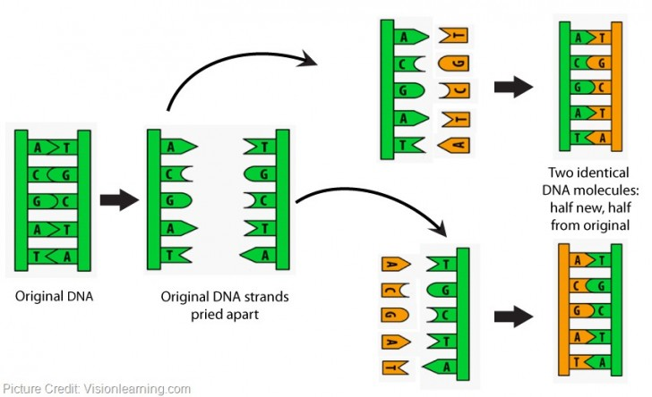
DNA Replication
WITH ENZYMES !
DNA replication explained
DNA Replication: The Cell's Extreme Team Sport - YouTube
Process is
“semi-conservative”

Slide 10
How does DNA determine your traits?
DNA is used as a code for protein synthesis
One gene, one protein
What is a gene?
A sequence of DNA that codes for a particular protein (proteins determine traits!)
DNA
Protein
Trait

Slide 11
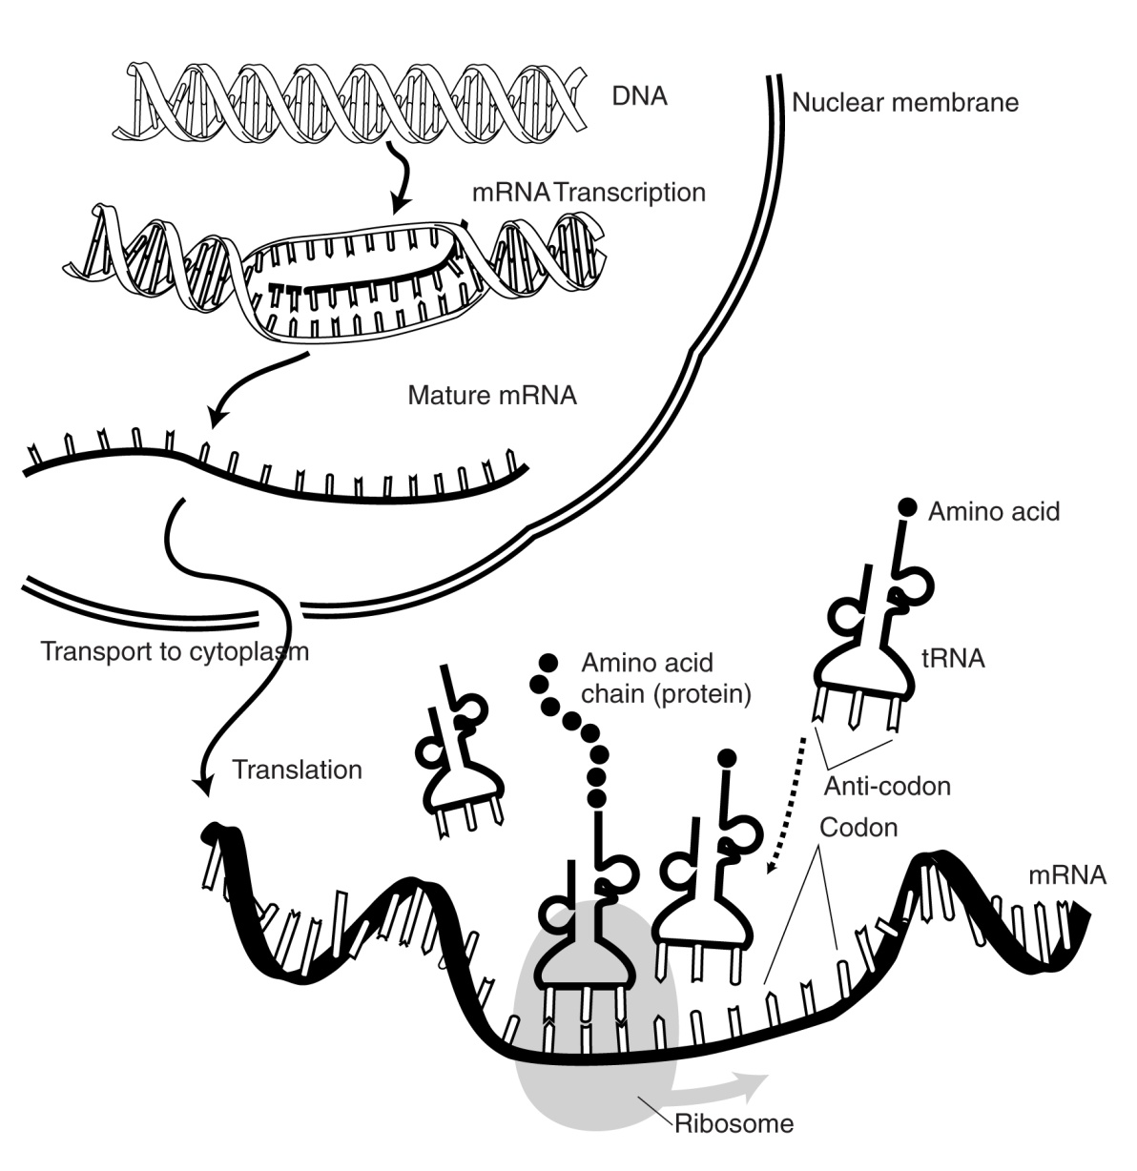
Process of Protein Synthesis
Transcription:
DNA → mRNA
(in nucleus)
Translation:
mRNA→ protein
(at ribosome in cytoplasm)

Slide 12
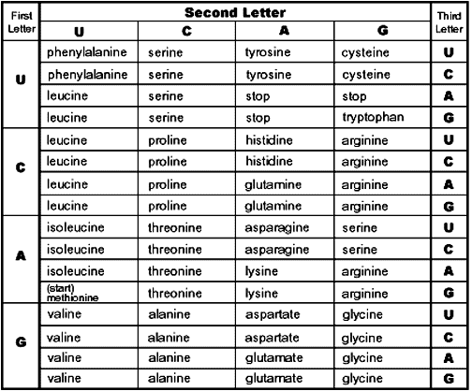
mRNA codon chart
DNA: TAC TCA CGT GTC ACT
RNA (codons): _________________________
Amino acids: _________________________

Slide 13
3 Types of RNA
mRNA: copies a gene from DNA
(messenger)
tRNA: brings amino acids to ribosomes,
(transfer) based on the mRNA codons
rRNA: makes up the ribosome
(ribosomal)

Slide 14
What happens when protein synthesis goes wrong?
Mutations:
Changes in DNA
Occur when DNA is being copied
May be spontaneous, or a result of environmental factors (mutagens)

Slide 15
Mutations
Two types of mutations:
Point mutation: One base pair is changed
Changes ONE amino acid
Frameshift mutation: One base pair is added or deleted
Results in a changes from that point forward
YouTube - Sickle Cell
YouTube - DNA MUTATION
YouTube - Beneficial Mutations Do Happen

