Slide 1
Protists
Miss Schwippert
Biology

Slide 2
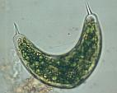
I. What are Protists?
A. (Mostly) uni-cellular EUKARYOTES that evolved around 2 billion years ago. They are very diverse and can seem similar to Plants, Animals, and Fungus.
We will look at 3 specific examples:
EUGLENA
PARAMECIUM
AMOEBA

Slide 3
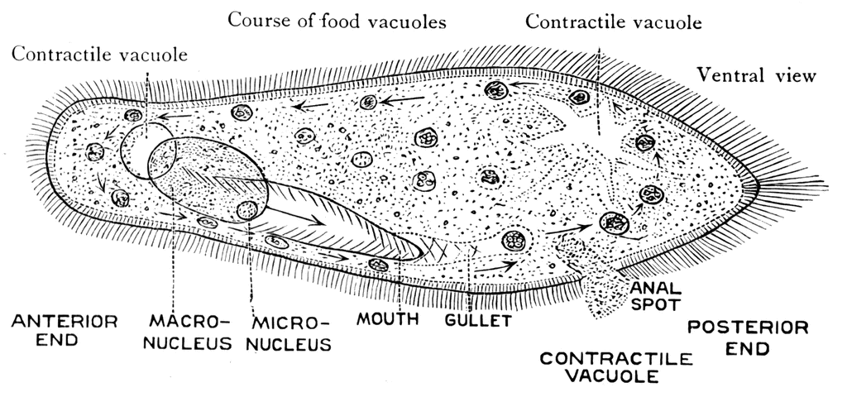
I. Paramecium
http://www.youtube.com/watch?v=a4aZE5FQ284
Transport: moves using CILIA (tiny hair like projections). CILIA can also help them grab food.
Excretion: uses its contractile vacuoles to excrete water/waste.
Respiration: uses diffusion to get oxygen (aerobic)
Nutrition: Heterotrophic (eats bacteria, algae) Engulfs food using its cilia which enter through the oral groove. The food is packed into a vacuole and enzymes break it down. Waste leaves via anal pore.
Reproduction: Sexual via conjugation OR Asexual using budding
Growth and development: none really they can “grow” by uptaking excess water/food
CAN USE CHEMOTAXIS/PHOTOTAXIS TO ORIENT IN THEIR ENVIRONMENT

Slide 4
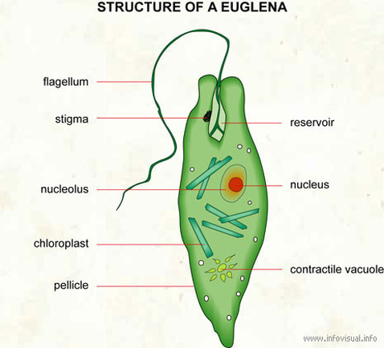
III. Euglena
http://www.youtube.com/watch?v=fI7nEWUjk3A
Transport: moves using a FLAGELLA.
Excretion: uses its contractile vacuole
Respiration: uses diffusion to get oxygen (aerobic)
Nutrition: Mainly photosynthetic (BECAUSE IT HAS EATEN ALGAE) using chloroplast but can engulf food, if needed
Reproduction: Asexual using Mitosis
Growth and development: none really they can “grow” by uptaking excess water/food
CAN USE PHOTOTAXIS TO ORIENT IN THEIR ENVIRONMENT

Slide 5
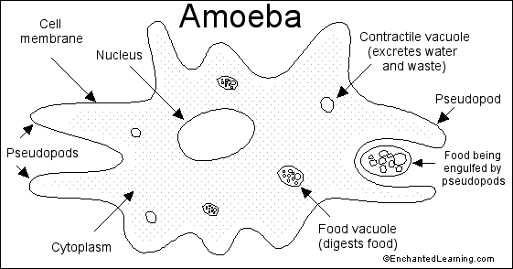
II. Amoeba
http://www.youtube.com/watch?v=7pR7TNzJ_pA
Transport: moves using PSEUDOPODS which can also help them grab food.
Excretion: uses its contractile vacuoles to excrete water/waste.
Respiration: uses diffusion to get oxygen (aerobic)
Nutrition: Heterotrophic Engulfs food using its pseudopods which break fold inward to create a vacuole. Enzymes break it down. Waste leaves via diffusion.
Reproduction: Asexual using mitosis
Growth and development: none really; they can “grow” by uptaking excess water/food
CAN USE CHEMOTAXIS/PHOTOTAXIS TO ORIENT IN THEIR ENVIRONMENT

