Slide 1
Classification- Fungi
Biology
Miss Schwippert

Slide 2
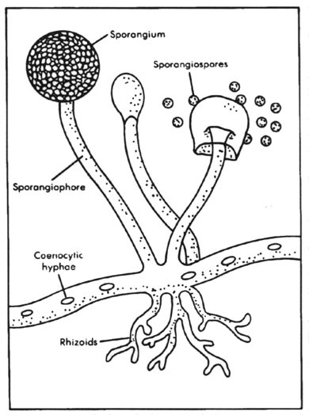
Importance
role as decomposers
source of antibiotic drugs
important for fermentation (bread, alcohol)

Slide 3
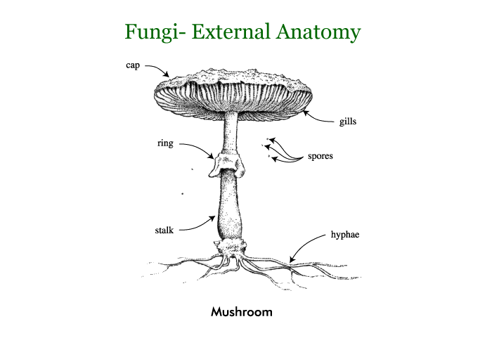
Characteristics
Multicellular
Eukaryotic
Cell Wall (made of chitin instead of cellulose)
Externally digest food and absorb nutrients

Slide 4
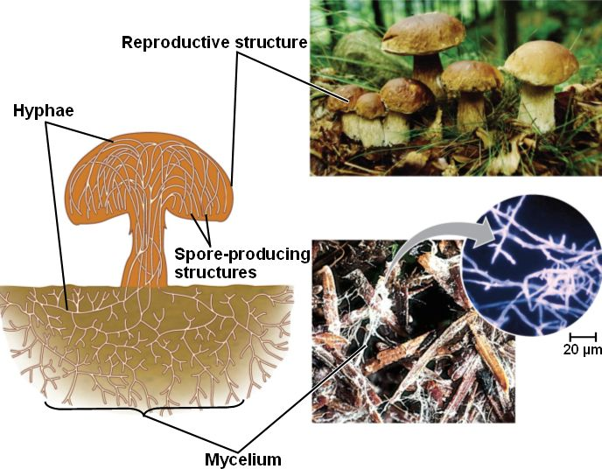
Structure
hyphae- search out and digest food
fruiting bodies- spore production
mycelium- search for food

Slide 5
Obtaining Food
secrete strong acids and powerful digestive enzymes
must be dissolved in water (that is why fungi are found in moist areas)
absorb nutrients through cells

Slide 6
Types of Fungi
Saprophytes- feed off nonliving organic compounds
Fungal parasites- feed from living organisms
Mutualistic fungi- live symbiotically with another organism

Slide 7
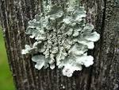
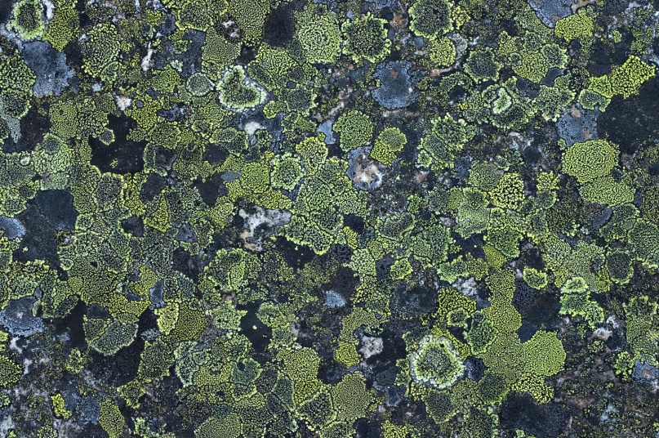
Divisions
Lichens- symbiotic relationships- lichen & algae
Zygote- soil dwelling decomposers- molds
Sac fungi- all make spore containing sacs- yeast
Imperfect fungi- only capable of asexual reproduction- penicillin
Club fungi- possess basidia which are club shaped structures that produce spores- guild mushrooms

Slide 8
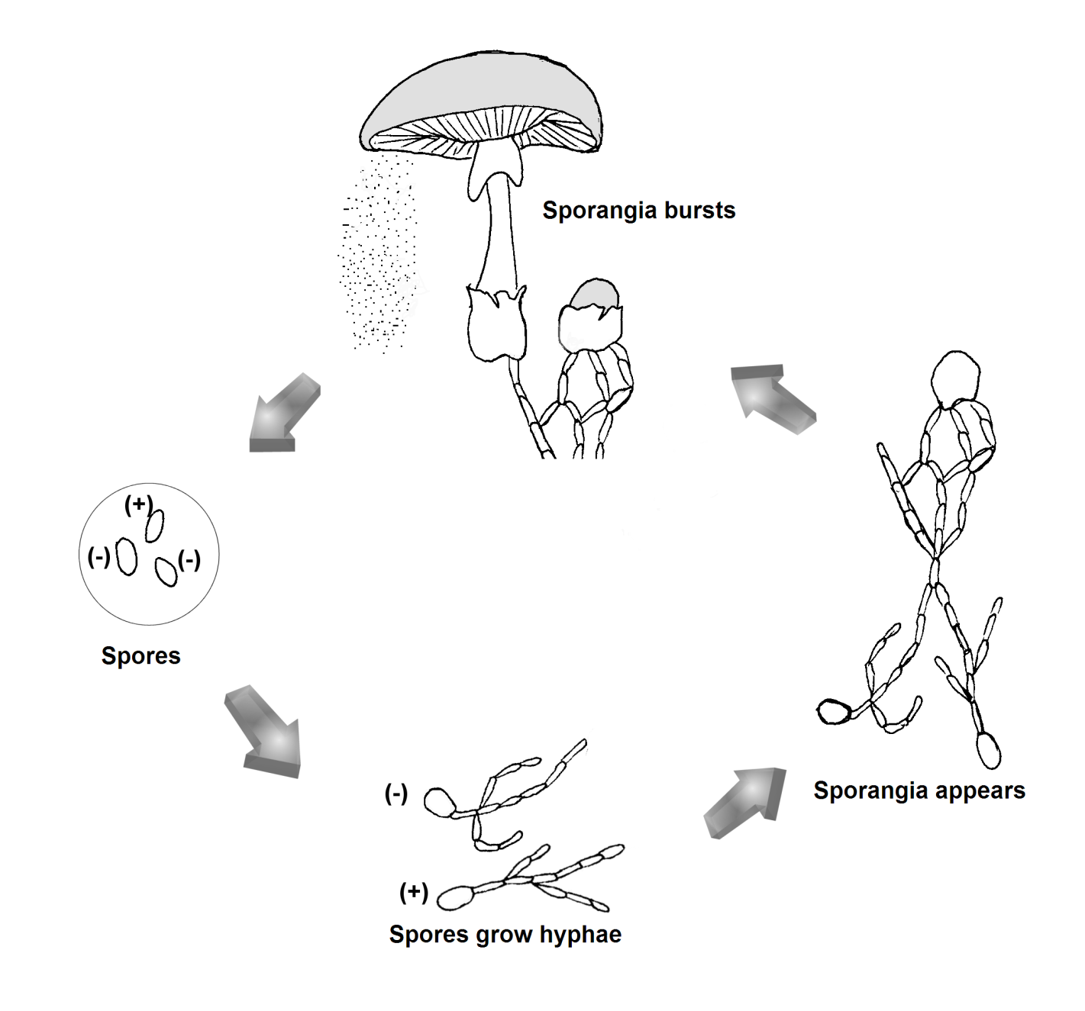
Reproduction
mushrooms are fruiting bodies that contain gills where basidiae are located
on each basicidiae contains 2 haploid nuclei that fuse together during fertilization to form a diploid nucleus
diploid nucleus will go through meiosis and form 4 haploid cells
haploid cells- called basidiospores- are located in newly formed sacs
spores fall to the earth and are picked up by the wind
spores will germinate in the ground and form hyphae which will draw in nutrients as they grow (kills parent mushroom)
hyphae will mate with hyphae of another mushroom and the cycle starts over again

