Slide 1
Classification- Animal Behavior
Biology
Miss Schwippert

Slide 2
BEHAVIOR
A Response to a Stimulus
INSTINCT/INNATE: A behavior you are born with; genetically programmed and hard to change

Slide 3
Innate versus Learned
Born with the behavior/Genetically programmed
Hard to change
Mostly in solitary animals or those with no parental care
Acquire behavior via experience
Can be changed or modified based on environment
Usually a result of social interaction or parental care

Slide 4
MIGRATION: Movement to find food or mates
Same path/time each year. The route may be learned in some animals
Bats, Whales, Butterflies
A Response to a Stimulus-Instinct

Slide 5
TAXIS: Movement towards or away from a stimulus
Pill Bugs move away from light (PHOTOTAXIS)
Positive= move toward the light
Termites follow chemical signals towards food (CHEMOTAXIS)
A Response to a Stimulus-Instinct:

Slide 6
HIBERNATION OR ESTIVATION: Hibernation is a state of dormancy to endure cold weather.
Estivation is dormancy in hot weather
Conserves resources
Adaptation to survive extremes

Slide 7
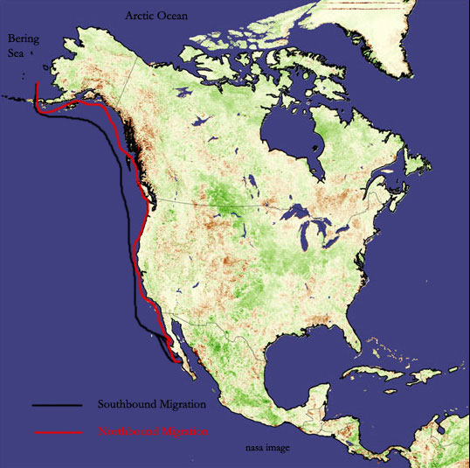
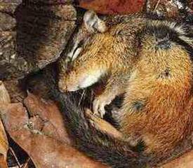
Migration: moving from area to area to gain resources.
Hibernation/Estivation: a period of dormancy during which resources are conserved
https://www.youtube.com/watch?v=TpY4frpheWw

Slide 8
BEHAVIOR
A Response to a Stimulus
LEARNED: A behavior acquired through experiences; found most often in social animals or animals that get parental care.
A Response to a Stimulus-LEARNED:

Slide 9
IMPRINTING
Habituation
Learning that occurs during a critical period
Failing to respond to a stimulus because there is no apparent consequence
Prairie dogs stop whistling warning calls when they live near human activity
Learn who your parents are or who to mate with
Think of the Boy Who Cried Wolf
A Response to a Stimulus-LEARNED:

Slide 10
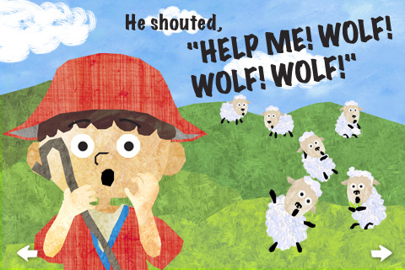
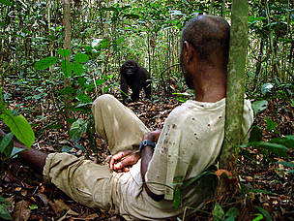
Habituation: losing a response to a stimulus.

Slide 11
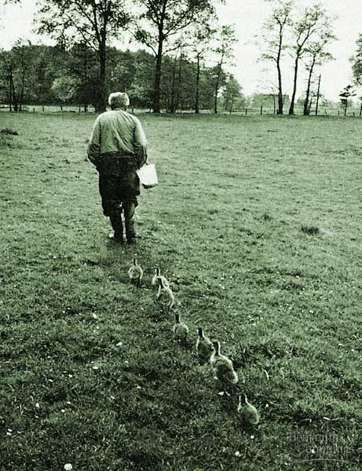
Imprinting: phase sensitive behavior that happens during a critical period of time. Helps animals learn who to trust, court, etc.
https://www.youtube.com/watch?v=7OynlzqtxmY

Slide 12
Classical Conditioning
Trial and Error or Operant Conditioning
Learning to respond to a neutral stimulus where the response is an instinctual response to an environmental stimulus
Riding a bike
Birds learn what foods to eat
Pavlov's Dogs...Classic
A Response to a Stimulus-LEARNED:

Slide 13
BEHAVIOR
A response to a stimulus
BEHAVIOR
A response to a stimulus
BEHAVIOR
A response to a stimulus
Social Behaviors: Behaviors that occur when animals live in large groups OR when 2 animals come together to mate or parent.
A Response to a Stimulus-Social Behavior:

Slide 14
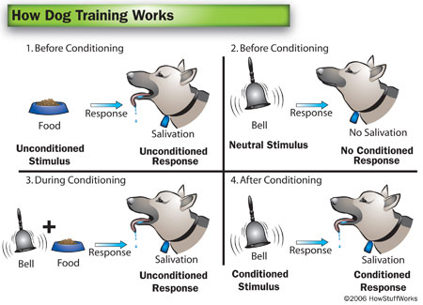
Classical Conditioning: producing a response to an unrelated stimulus. May play a role in the development of phobias.
https://www.youtube.com/watch?v=Eo7jcI8fAuI

Slide 15
Courtship Displays
Communication: can take many forms: whistles clicks, chirps, body language, etc
Also used to limit cross species reproduction
May be done to show "FITNESS"
Chimpanzees vocalize different sounds for different situations
Waggle Dance in Bees to find food
Male Bowerbirds build elaborate nests for females to inspect.
A Response to a Stimulus-Social Behavior:

Slide 16
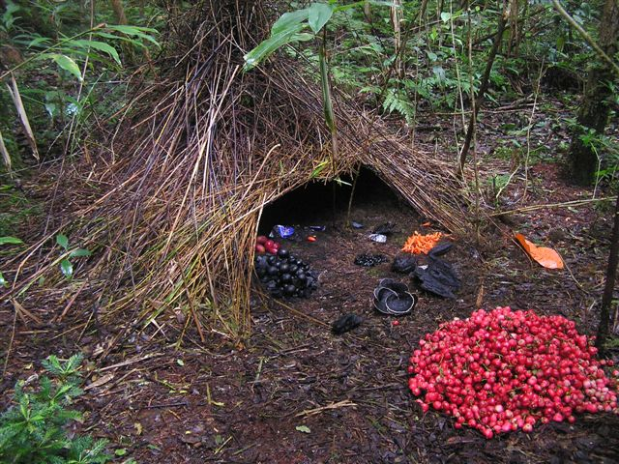
courtship- birds
https://www.youtube.com/watch?v=cEh-zclVo44

Slide 17
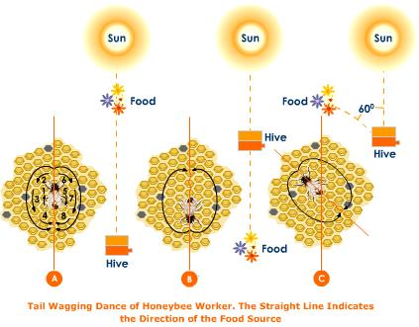
Communication: occurs in social animals to help find food, show emotion, or find a mate (pheromones)

Slide 18
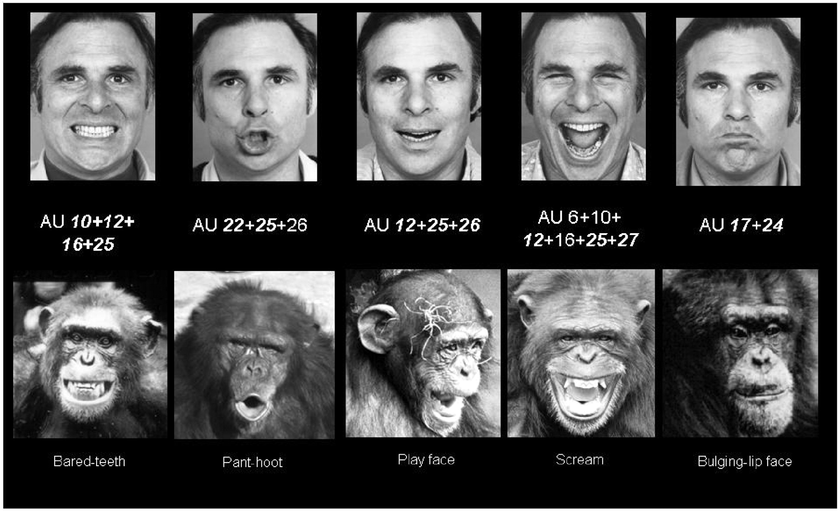
https://www.youtube.com/watch?v=LjnerzOqz-w

Slide 19
Territoriality: behaviors used to defend nesting sites, food, or mates
Territory Fight
Male moose dig a rutting pit and urinate in it, then splash around. Marks their territory and attracts females....
A Response to a Stimulus-Social Behavior:

